Slide 1
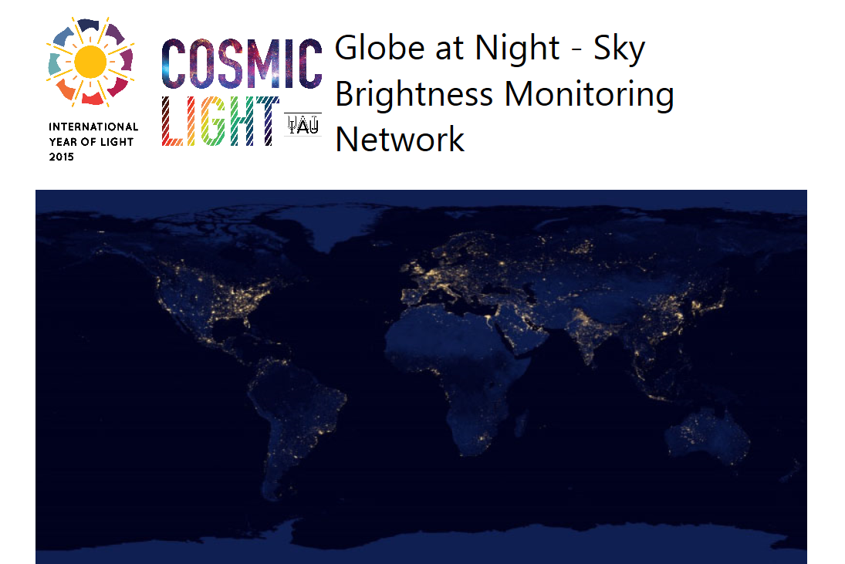

Yonggi Kim, Chungbuk National University

Slide 2
Globe at Night, Korea? How?
Campaign
Measuring the sky brightness with SQM
Data analysis of the sky brightness in Korea
Report to Globe at Night Network
Education
Dark skies Rangers Program in the Astro auto camping program at University Observatory of Chungbuk National University (CBNUO)
Countrywide outreach education program with Activity guide of Globe at Night web site
Translation of the Globe at Night web site into Korean

Slide 3
Globe at Night, Korea : I. Campaign
Sponser
The Korean Astronomical Society
The Korean Space Science Society
Korean Astronomy & Space Science Institute
To do
About 40 SQMs will be distributed to universities, science high school as well as public observatories
The observation network will be organized
Data will be analysed in CBNUO
Countrywide outreach education program with Activity guide of Globe at Night web site
Translation of the Globe at Night web site into Korean

Slide 4
Globe at Night, Korea : II. Education
Astro Auto Camping
18 camping sites at CBNUO
Hands-on Astronomy program with Family
Observation experience
To do
About 40 SQMs will be distributed to universities, science high school as well as public observatories
The observation network will be organized
Data will be analysed in CBNUO

Slide 5
Globe at Night, Korea : II. Education
Astro Auto Camping
The Korean Astronomical Society
The Korean Space Science Society
Korean Astronomy & Space Science Institute
To do
Activities of Globe at Night will be added to the program
Dark skies Rangers Korea will be organized
Countrywide outreach education program with Activity guide of Globe at Night web site
Translation of the Globe at Night web site into Korean

Slide 6
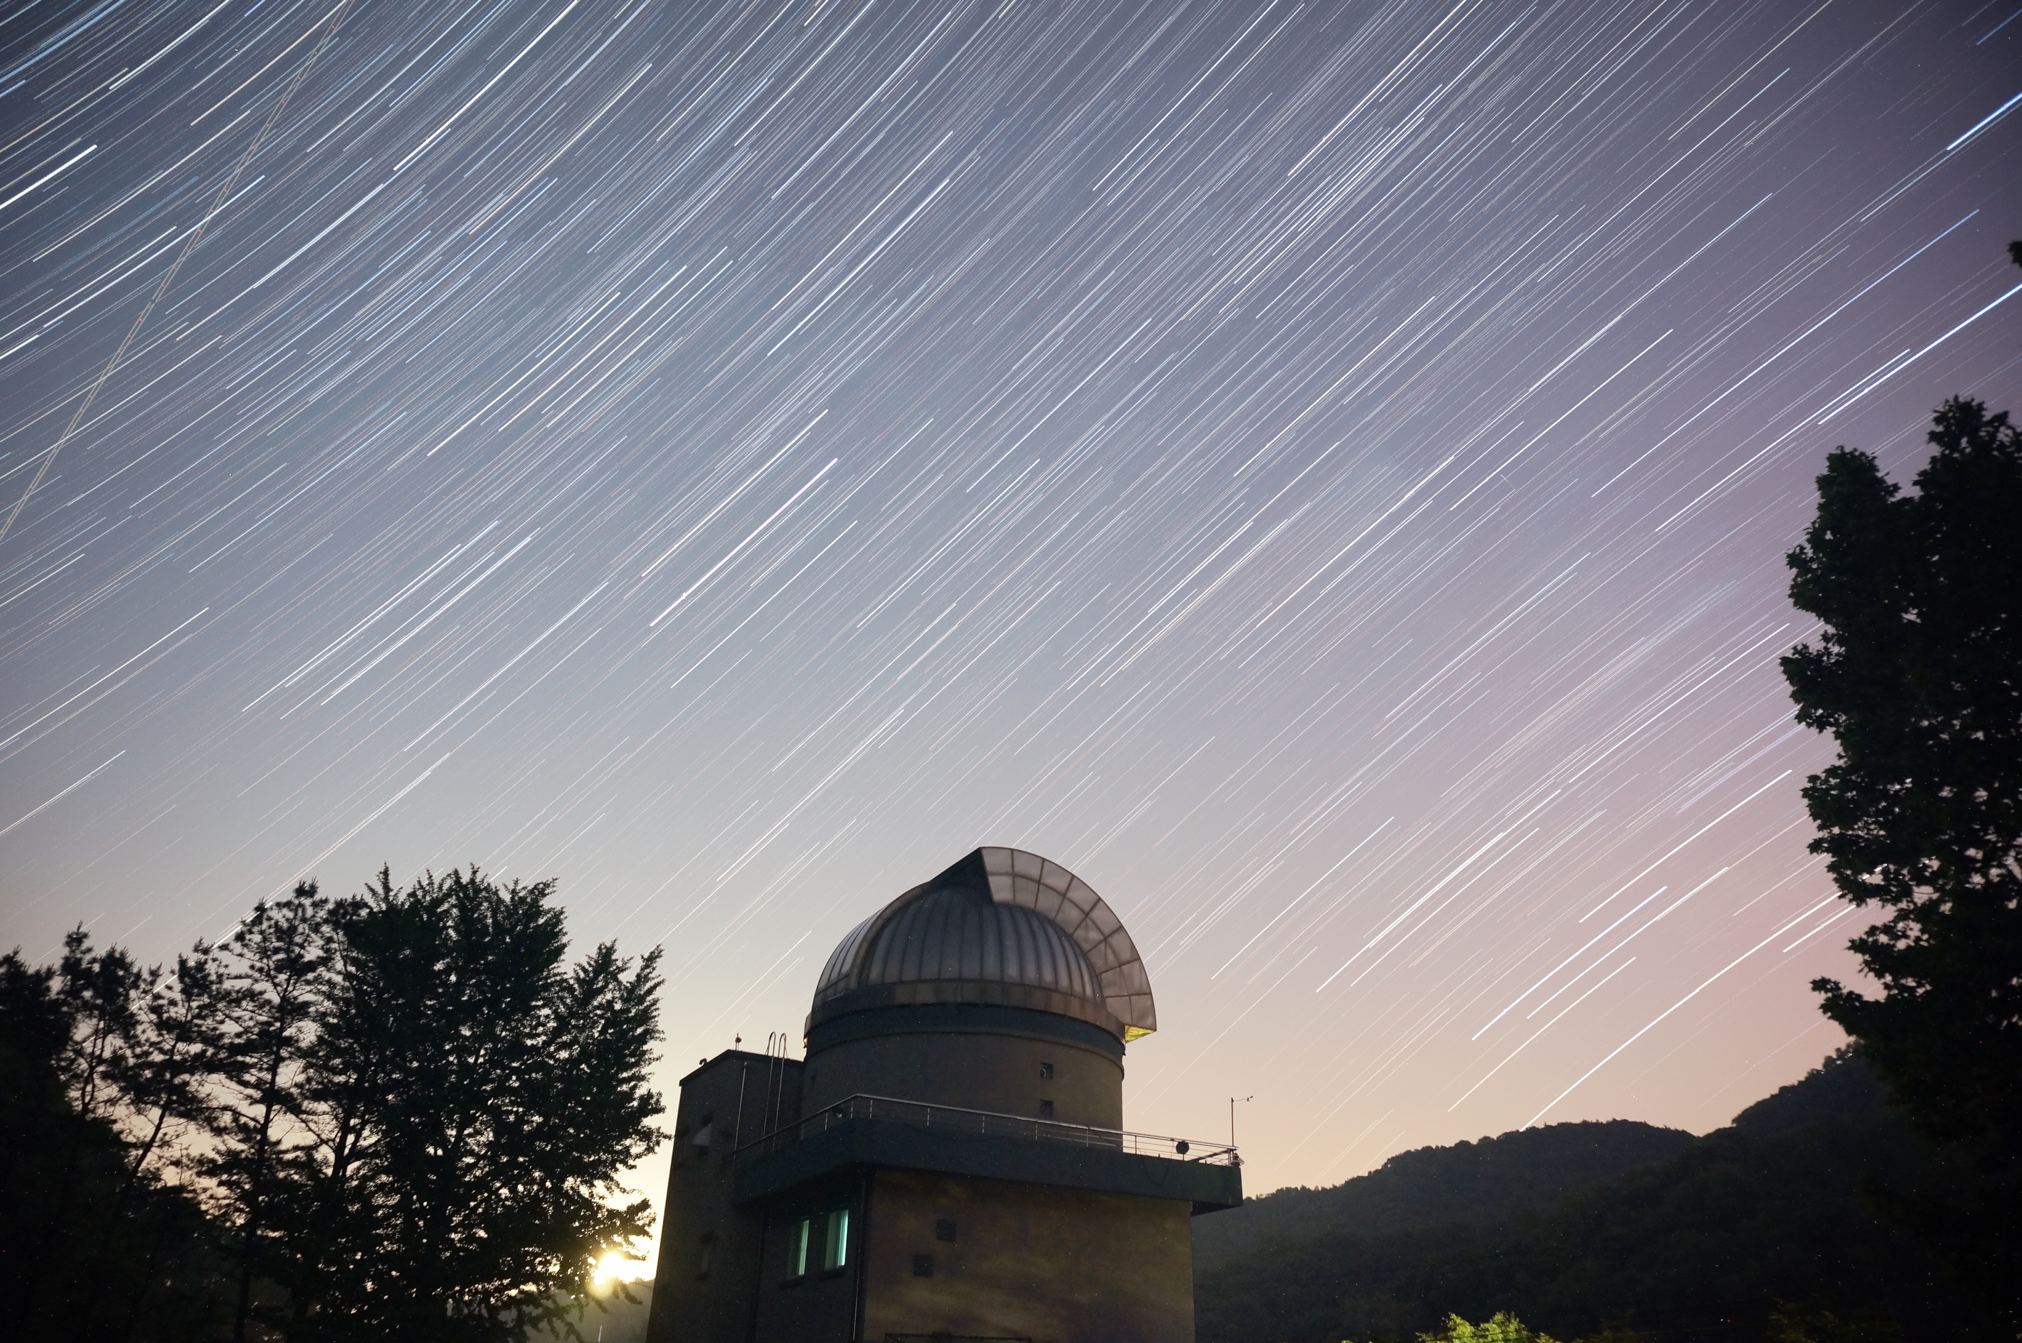
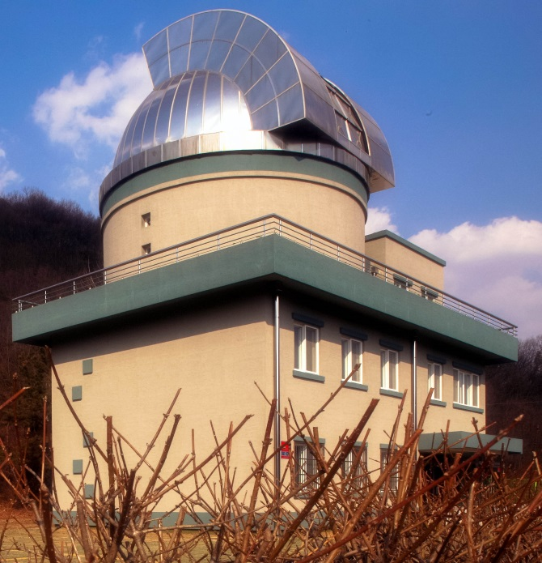
University Observatory, CBNU (CBNUO)

Slide 7
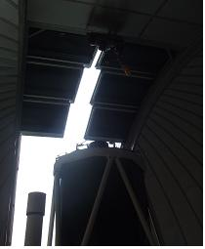
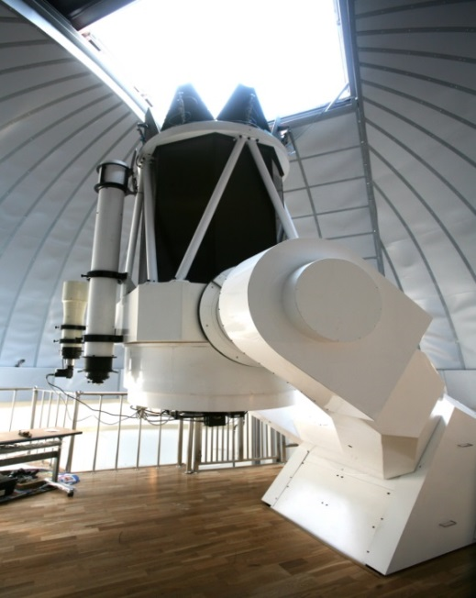
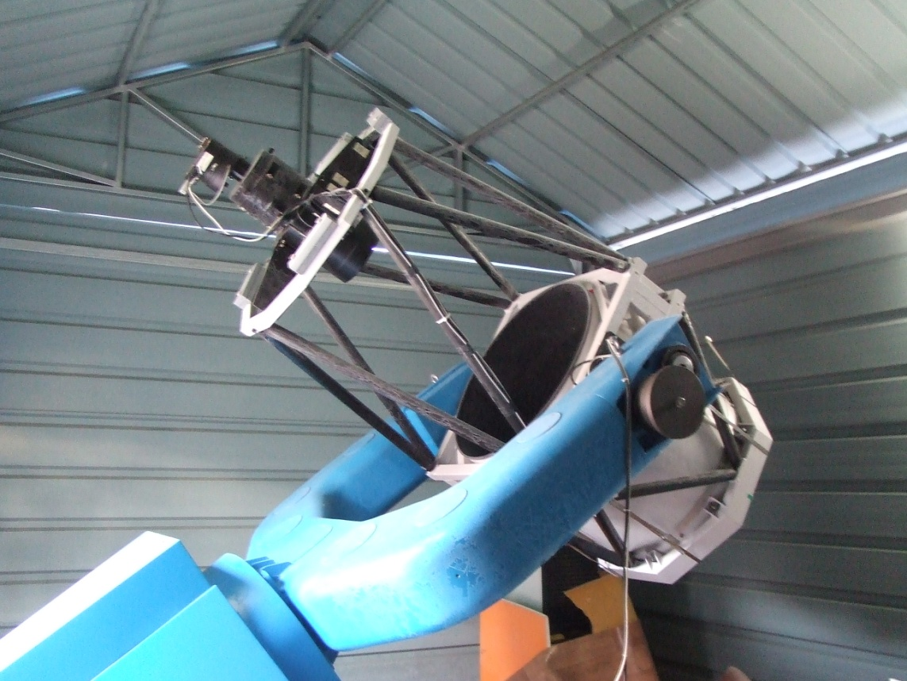

CBNUO
2008.03.26
9.0m Dome
2008.03.26
2011.01.27
1.0m R-C Type Reflector
0.6m wide field Reflector

Slide 8
CBNUO services
Photometry of binaries
NEO
Magnetic cataclysmic variable
Automatic system
Management of
astronomy program
Remote observation
system
CBNUO
Develop astronomy program
Technical support
for public observatories
Training experts
for public astronomy
Hands-on program
For ancient astronomy
Ancient exibitons
Remaking of astronomical instruments

Slide 9
Astro auto camping with Family
CBNUO services
Since July, 2014

Slide 10
CBNUO Astro Auto Camping
a family friendly camping site since July 2014
Interesting astronomical hands-on program with family
Very positive feedback during last 6 months

Slide 11
Astro Auto camping Program (1st Day)
Time | Program | Details | Remarks
12:00 ~ 15:00 | Admission and pitching a tent | Check in with Family
15:00 ~ 16:00 | Lecture(A, B) | Astronomy class & Observatory tour | Free Time for Group C, D
16:00 ~ 17:00 | Lecture(C, D) | Astronomy class & Observatory tour | Free Time for Group A, B
17:00 ~ 20:00 | Free Time & Dinner
20:00 ~ 21:00 | Lecture(A, B) | Hand-on activity & Constellation | Free Time for Group C, D
21:00 ~ 22:00 | Lecture(C, D) | Hand-on activity & Constellation | Free Time for Group A, B
22:00 ~ 23:00 | Observation with Telescope | Observation

Slide 12
Astro Auto camping Program
(2nd Day)
Time | Program | Details | Remarks
10:00 ~ 11:00 | Lecture (Sun) & Solar Observation | Group AB & CD
11:00 ~ 14:00 | Free Time
14:00 | Check out | Go home with Family

Slide 13
Lecture and hands-on Activities
August : Space Science, Air Rocket
September: Moon, Observation of the phase of the Moon
October : Star cycle, H-R Diagram
November : Alien, Alien key holder
Some activities from Globe at Night (Dark skies Rangers) will be added to our activity program!

Slide 14
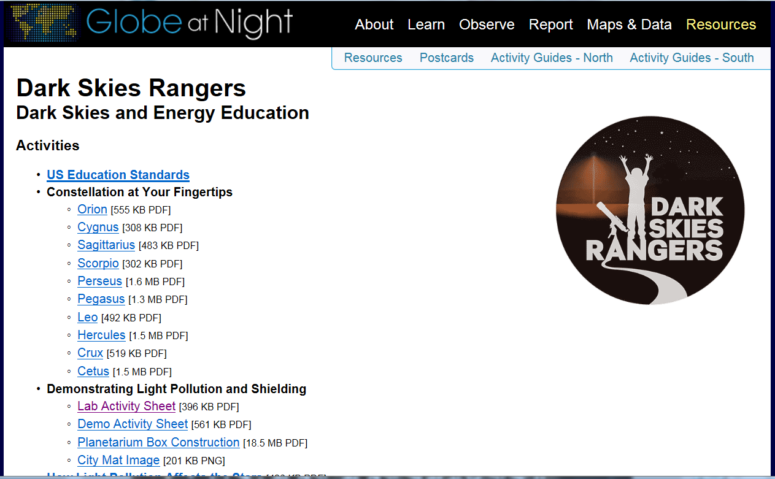
http://www.globeatnight.org/dsr/

Slide 15
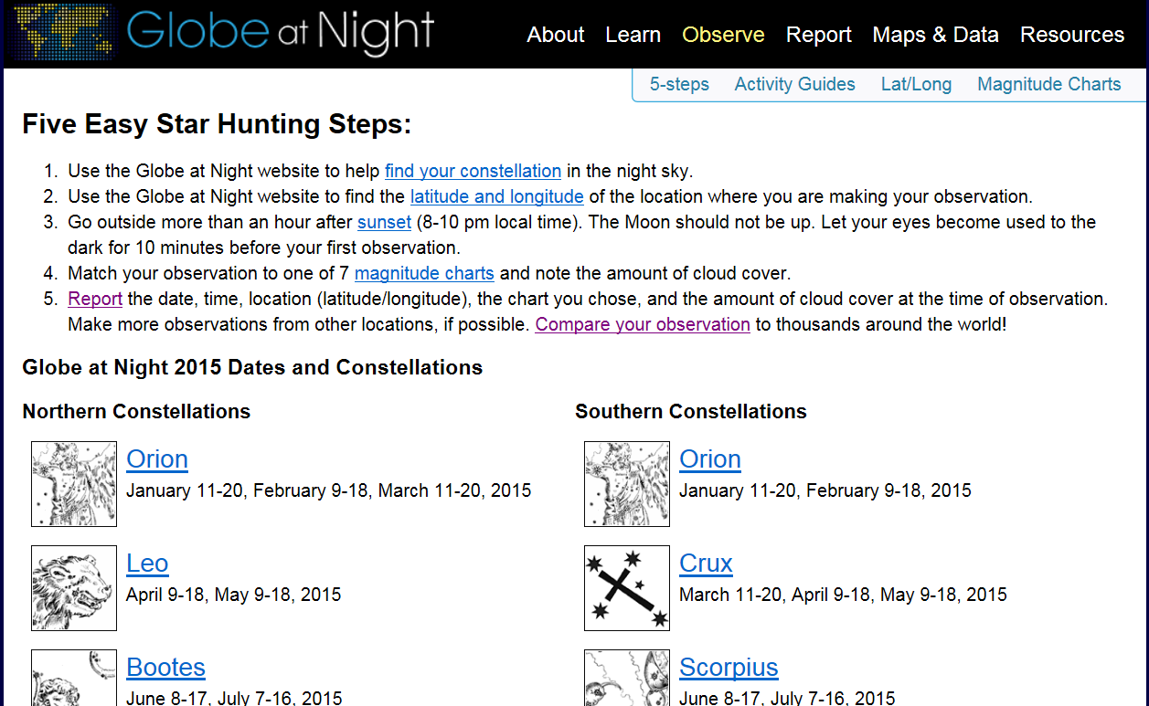
http://www.globeatnight.org/5-steps.php

Slide 16
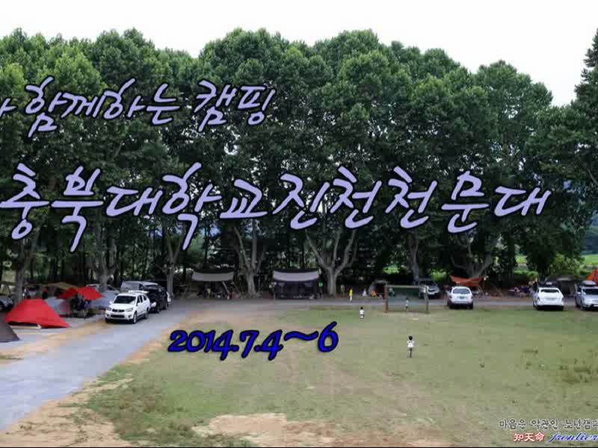

Slide 17
Glove at Night, Korea
Campaign
Measuring the sky brightness with SQM
Data analysis of the sky brightness in Korea
Report to Globe at Night Network
Education
Dark skies Rangers Program in the Astro auto camping program at University Observatory of Chungbuk National University (CBNUO)
Countrywide outreach education program with Activity guide of Globe at Night web site
Translation of the Globe at Night web site into Korean

