Slide 1
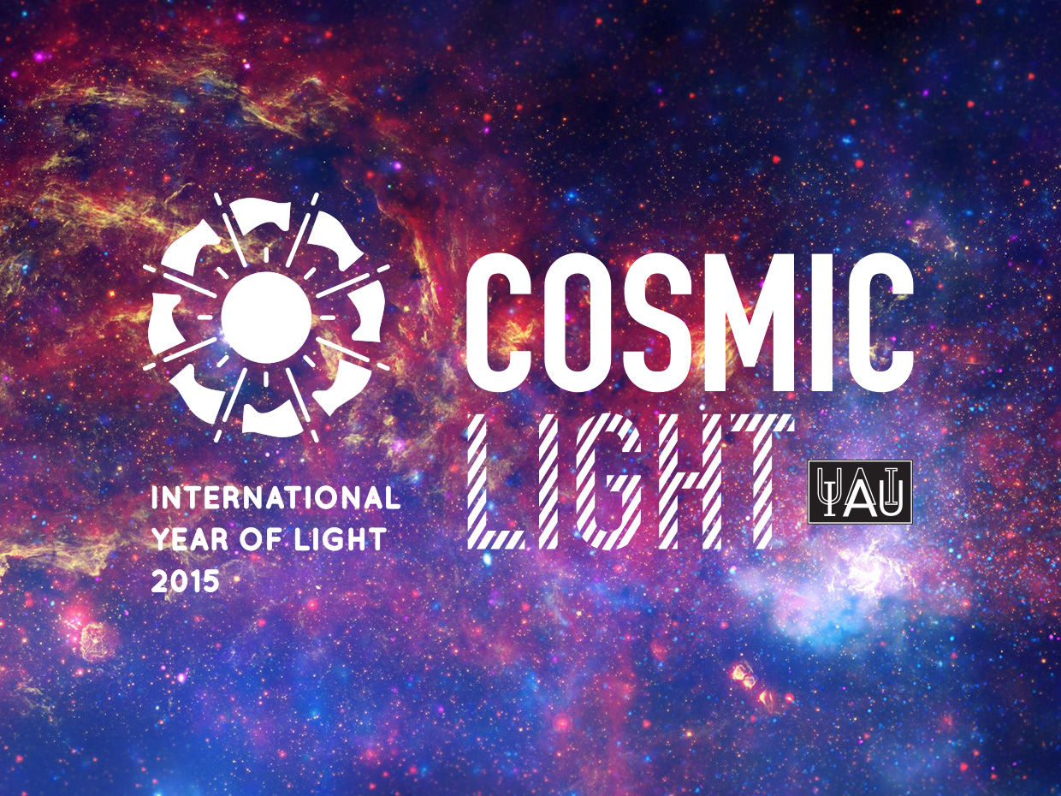
Sze-leung CHEUNG, IAU International Outreach Coordinator

Slide 2









Slide 3
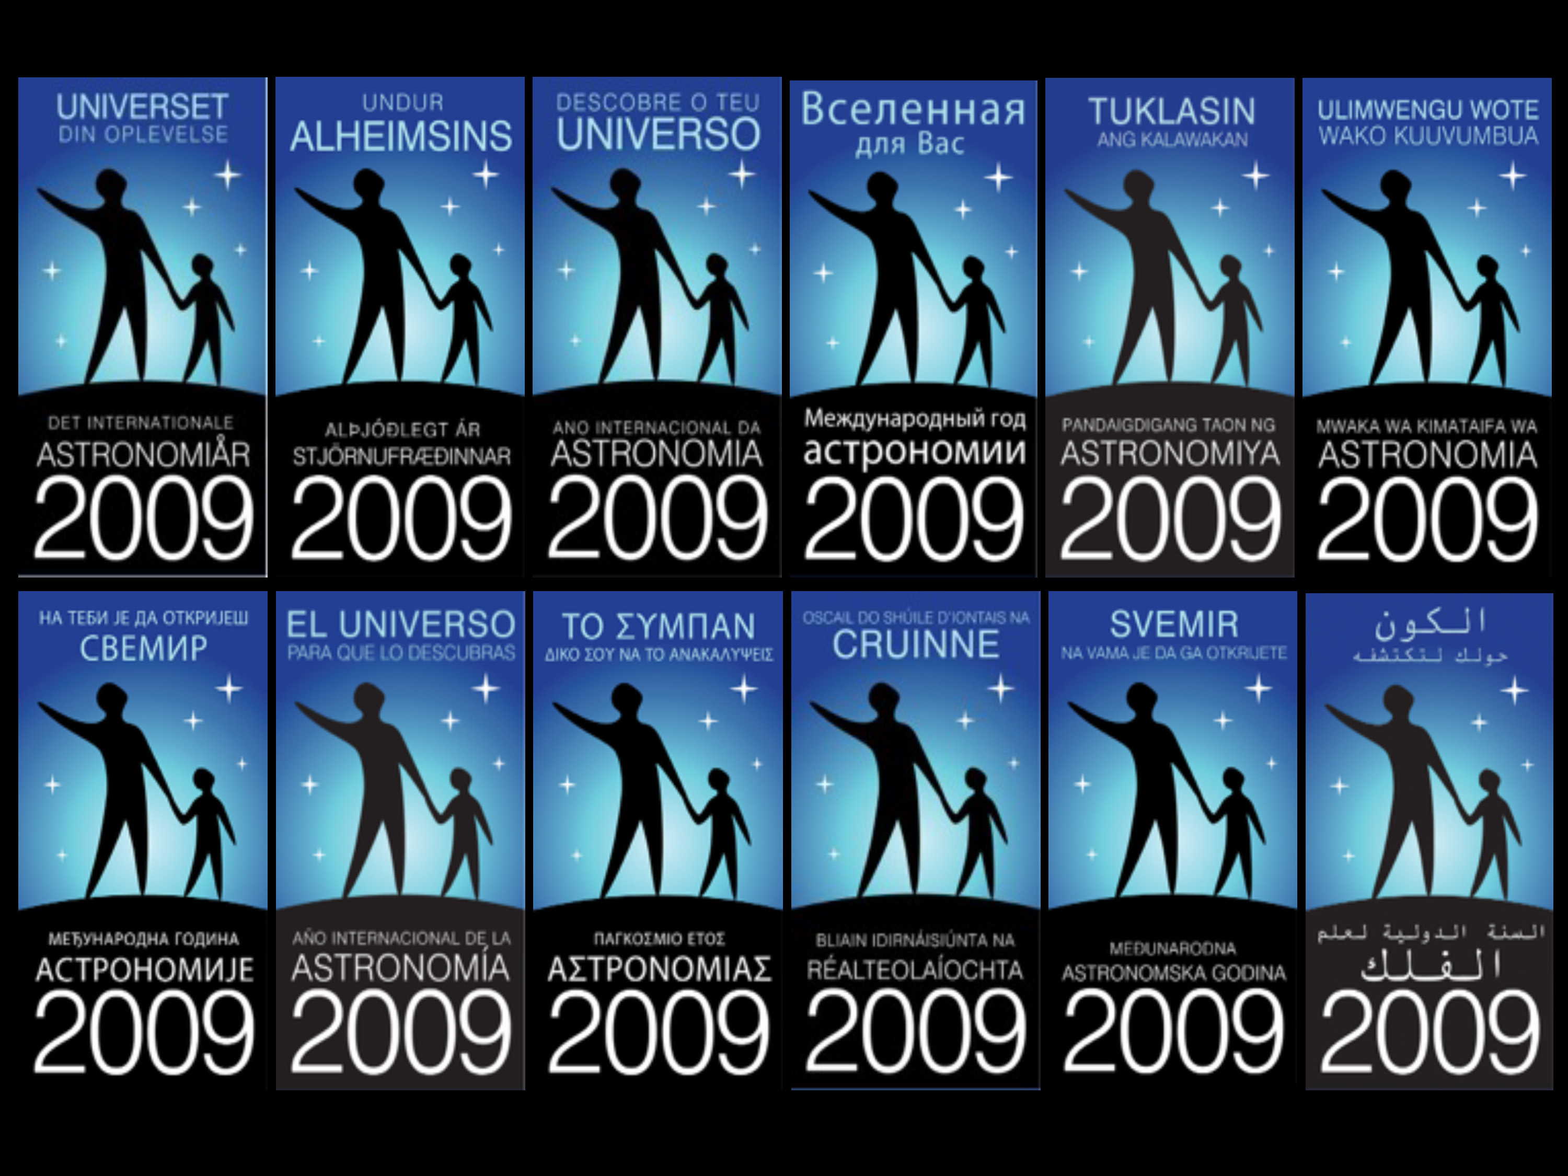

Slide 4
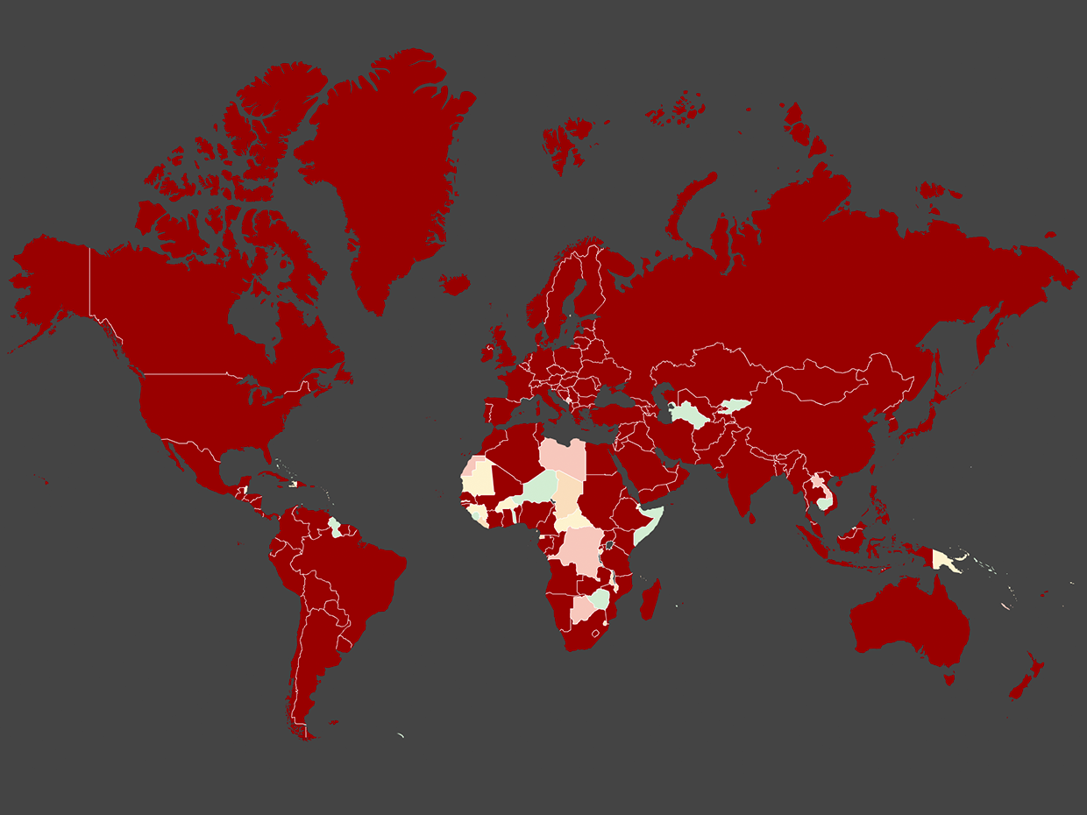
IYA2009 Single Point of Contacts (SPoCs)
Total number: 148
Others: 40 international organizations and 28 global projects
Comparison:
UN members: 195
IAU National members: 73

Slide 5
Number of People Reached
815 million
worldwide
~50% reports

Slide 6
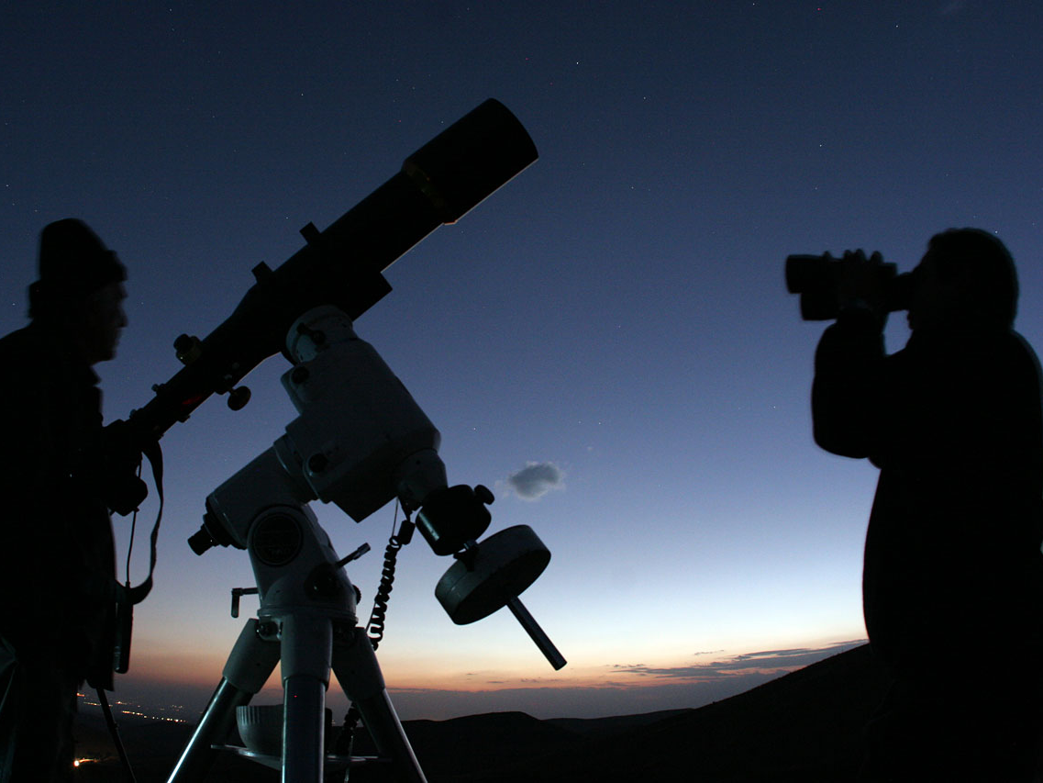
Amateur astronomers, Iran, 05.04.09
Notes:
Event: Observing Orion
Date: 5 April 2009
Place / country: Antofagasta, Chile
Photographer: @ Astro
URL: http://www.flickr.com/photos/farid-astro/3415479643/in/pool-iya2009

Slide 7
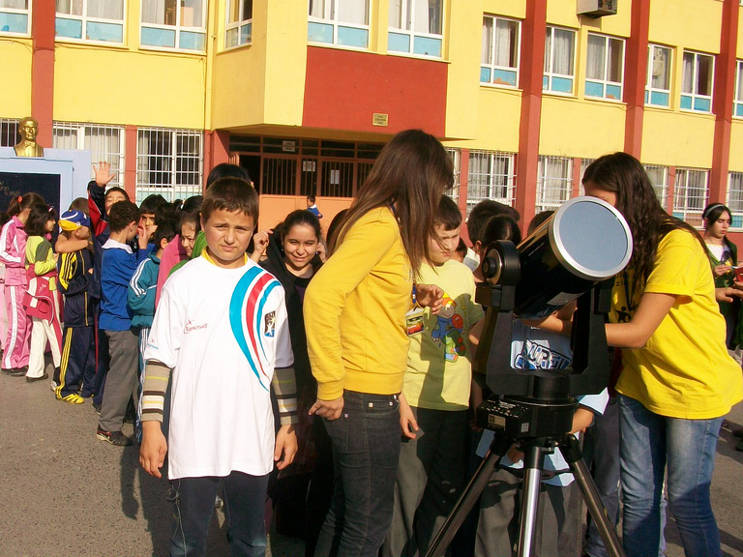
Galilean Nights, Kazim Karabekir, Turkey, 22.10.09
Notes:
Event: Observing Orion
Date: 5 April 2009
Place / country: Antofagasta, Chile
Photographer: @ Astro
URL: http://www.flickr.com/photos/farid-astro/3415479643/in/pool-iya2009

Slide 8
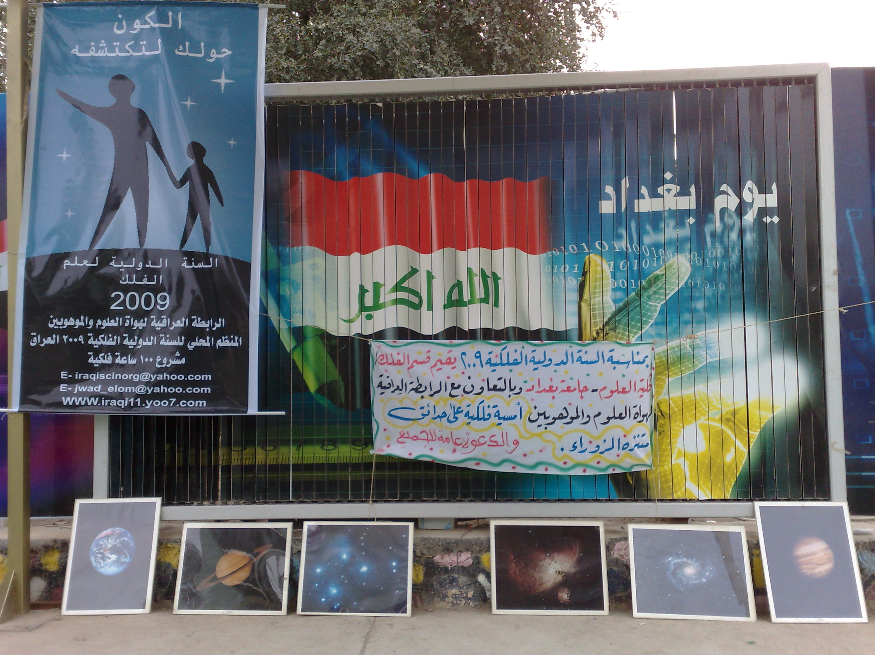
Astronomical exhibit, Baghdad, Iraq, August 2009
Notes:
17 countries have been awarded grants intended to stimulate astronomy activities in areas that include astronomy education workshops for teachers, the recording and preservation of indigenous astronomy knowledge, the production of school astronomy education resources in local languages and many more.

Slide 9
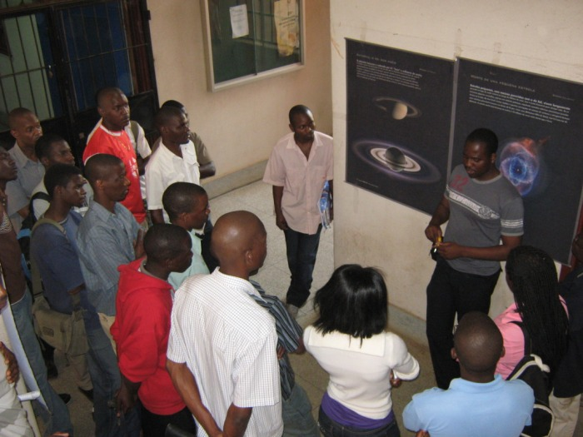
University lecture at the Eduardo Mondlane University, Maputo, Mozambique, July 2009
Notes:
17 countries have been awarded grants intended to stimulate astronomy activities in areas that include astronomy education workshops for teachers, the recording and preservation of indigenous astronomy knowledge, the production of school astronomy education resources in local languages and many more.

Slide 10
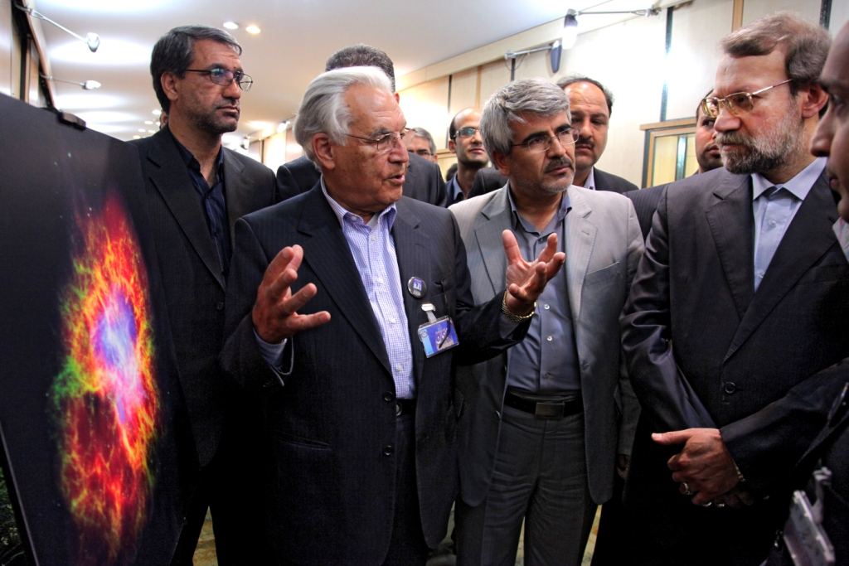
FETTU in the Iranian Parliament, Iran, 27.09.09
Notes:
Event: FETTU in Iranian Parliament
Date: 27 September 2009
Place / country: Iran
Photographer: Irene Shivaei
URL: http://www.flickr.com/photos/43225194@N08/3974654710/in/pool-iya2009

Slide 11
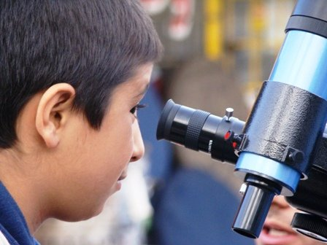
100 Hours of Astronomy, Iran, 04.04.09
Notes:
Event: 100 Hours of Astronomy
Date: 2-5 April 2009
Place / country: Iran
Photographer:
URL: http://www.100hoursofastronomy.org/photo-galleries/category/146-100-6-2

Slide 12
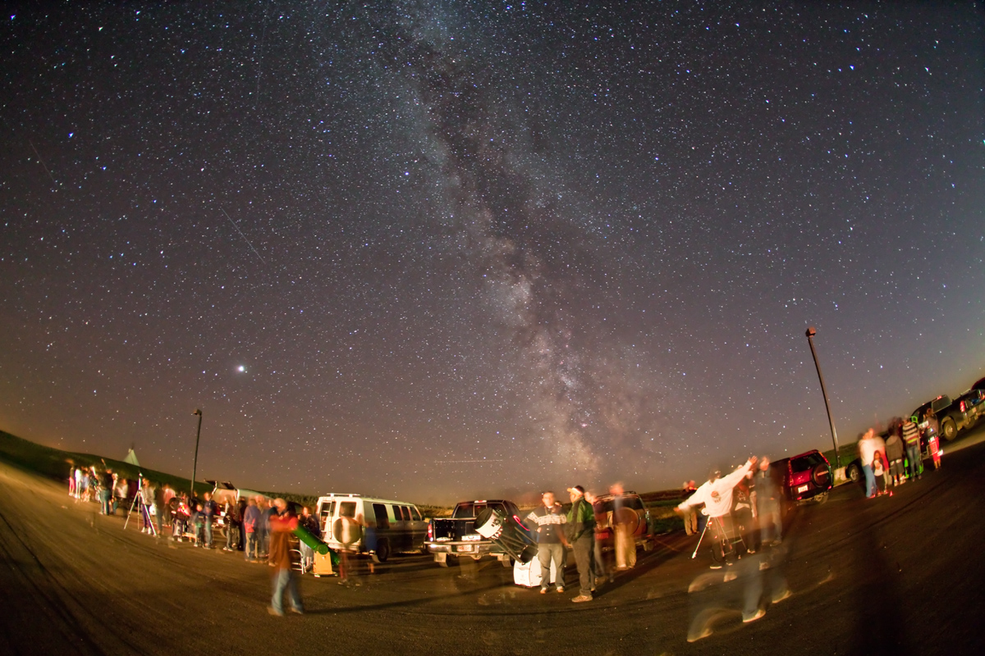
Star Party, Blackfoot Crossing Historical Park, Canada, 12.09.09
Notes:
Event: Star party
Date: 12 September 2009
Place / country: Blackfoot Crossing Historical Park, Canada
Photographer: IYACalgary
URL: http://www.flickr.com/photos/iyacalgary/3915235801/in/pool-iya2009

Slide 13
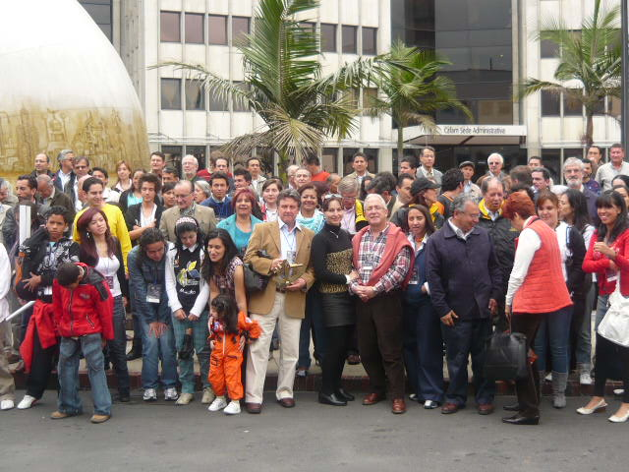
Colombian IYA2009 Ceremony, Colombia, 11.10.09
Notes:
Event: Colombian IYA2009 Ceremony
Date: 11 October 2009
Place / country: Colombia
Photographer: Colombian Astronomical Network
URL: http://www.flickr.com/photos/reddeastronomiadecolombia/4014343739/in/pool-iya2009

Slide 14
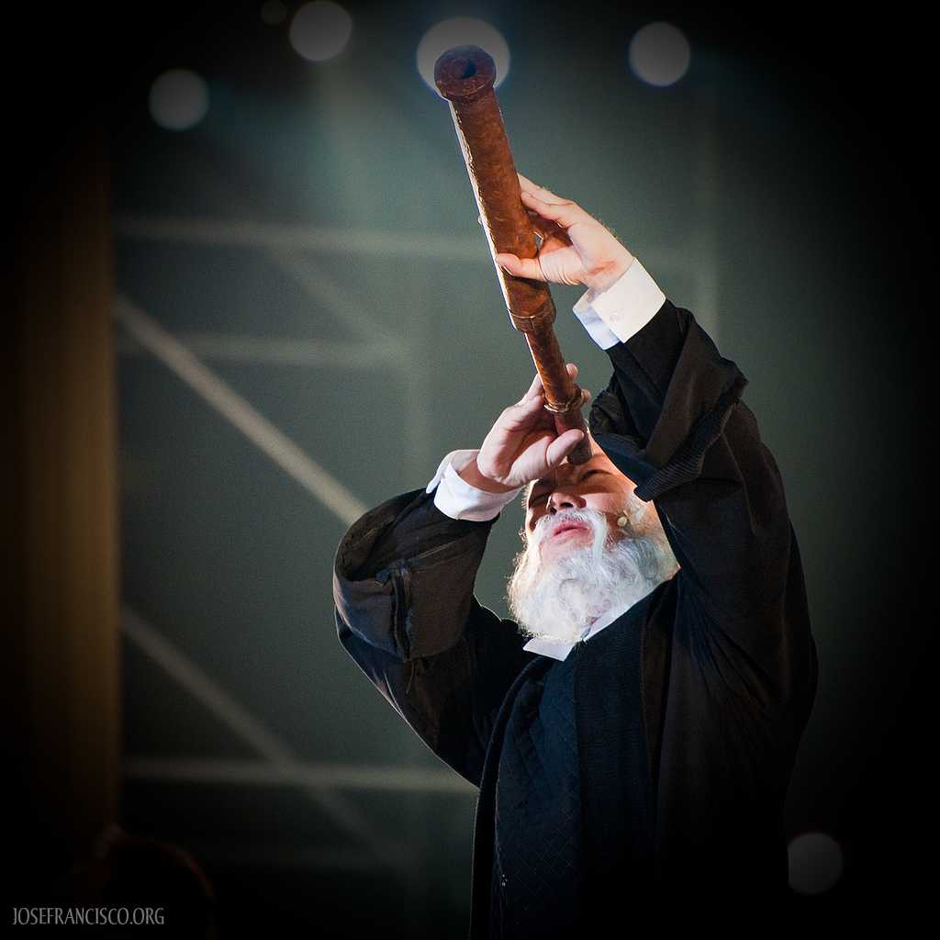
Drama depicting the life of Galileo Galilei, Taiwan, 21.03.09
Notes:
Event: Scene from a drama with dance and music depicting the life of Galileo Galilei.
Date: 21 March 2009
Place / country: Taiwan
Photographer: Jose Francisco Salgado
URL: http://www.flickr.com/photos/josefranciscosalgado/3388868699/in/pool-iya2009

Slide 15
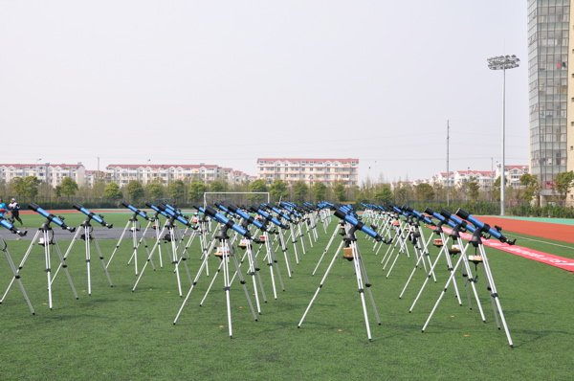
100 Hours of Astronomy, China, 04.04.09
Notes:
Event: 100 Hours of Astronomy
Date: 2-5 April 2009
Place / country: China
Photographer:
URL: http://www.100hoursofastronomy.org/photo-galleries/category/146-100-6-2

Slide 16
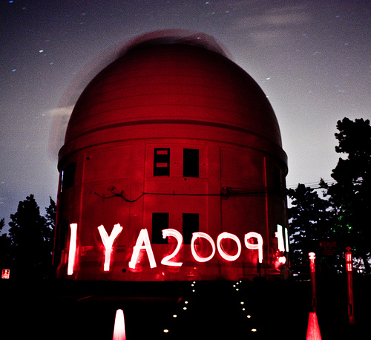
Light Painting Celebrating IYA2009, Victoria, British Columbia, Canada, 12.08.09
Notes:
Event: Light painting to celebrate IYA2009
Date: 12 August 2009
Place / country: Victoria, British Columbia, Canada
Photographer: screen name fail
URL: http://www.flickr.com/photos/screennamefail/3819413799/in/pool-iya2009

Slide 17
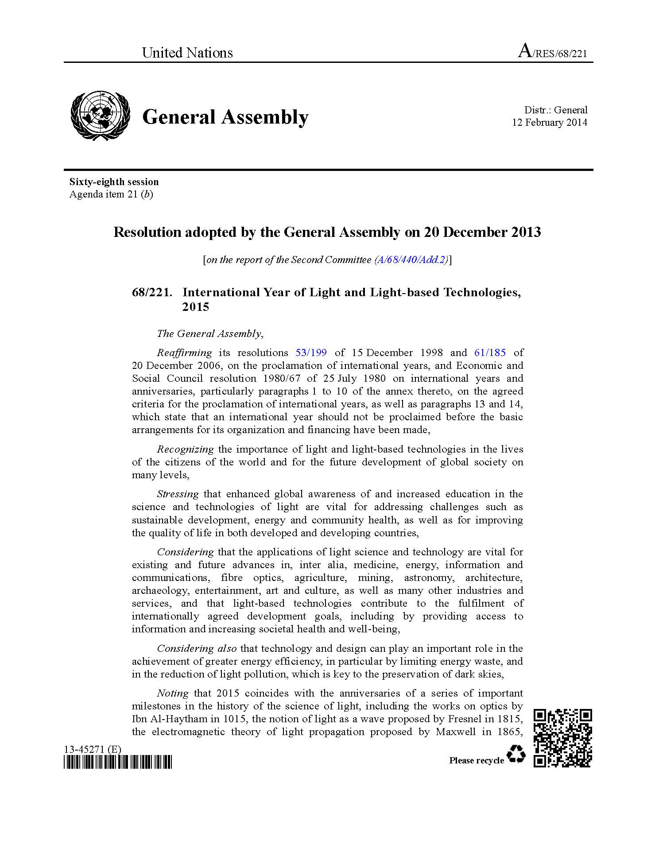
What?

Slide 18
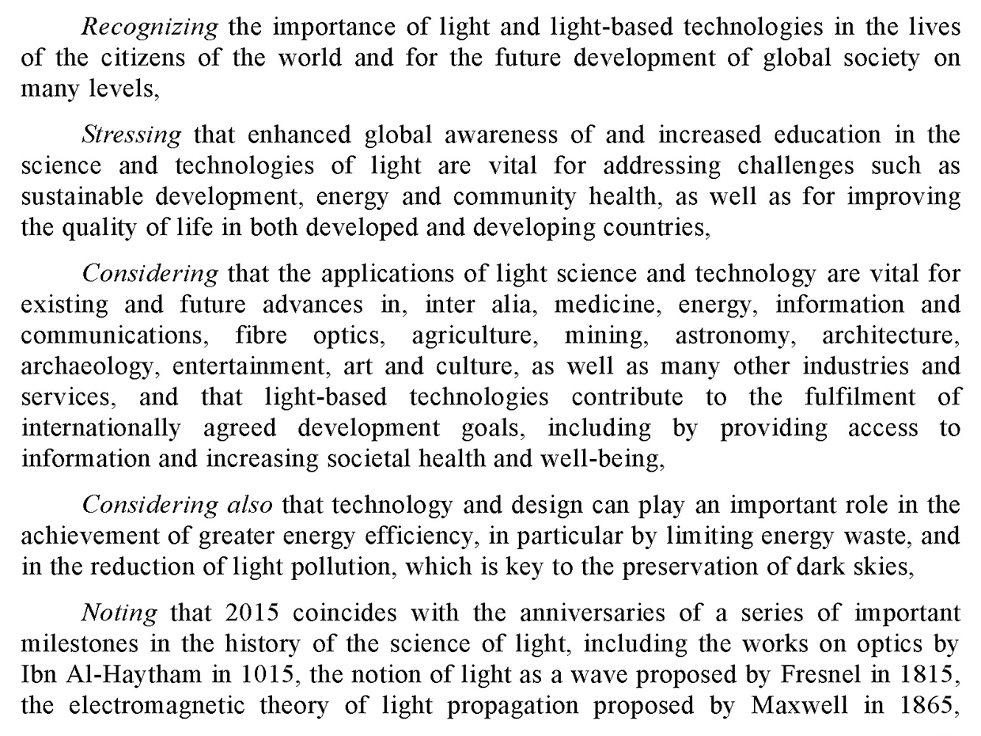

Slide 19
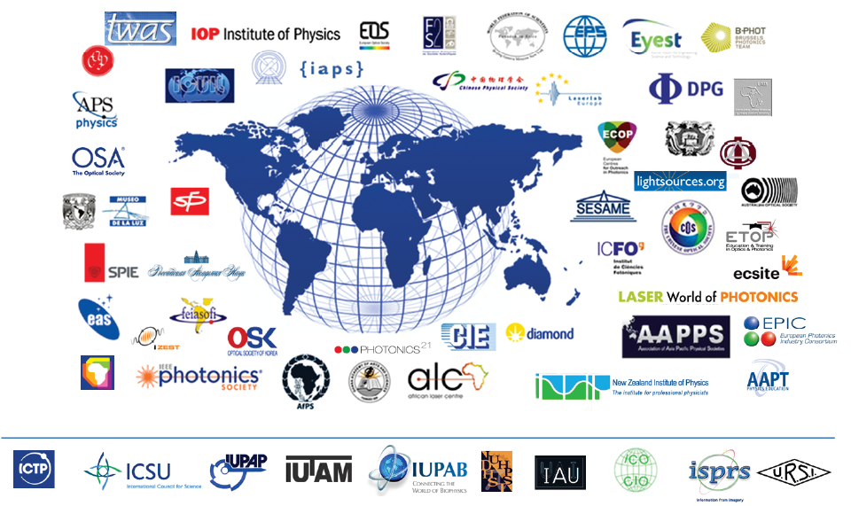










100+ partners from 85 countries

Slide 20
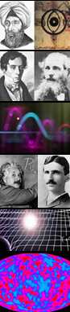
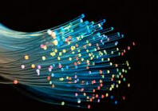
Anniversaries in 2015
1015: 1000 years of Arabic optics
1815: 200 years of Fresnel’s theory of diffraction
1865: 150 years since Maxwell’s electrodynamics
1915: Einstein Centenary, General Relativity.
1965: Big Bang, Penzias & Wilson Optical Fibre Technology, Charles Kao

Slide 21
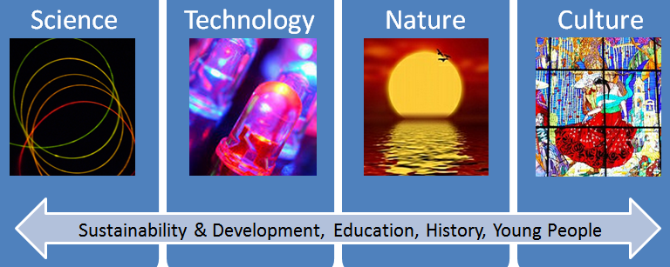
Opportunity for the future
Four major focus

Slide 22
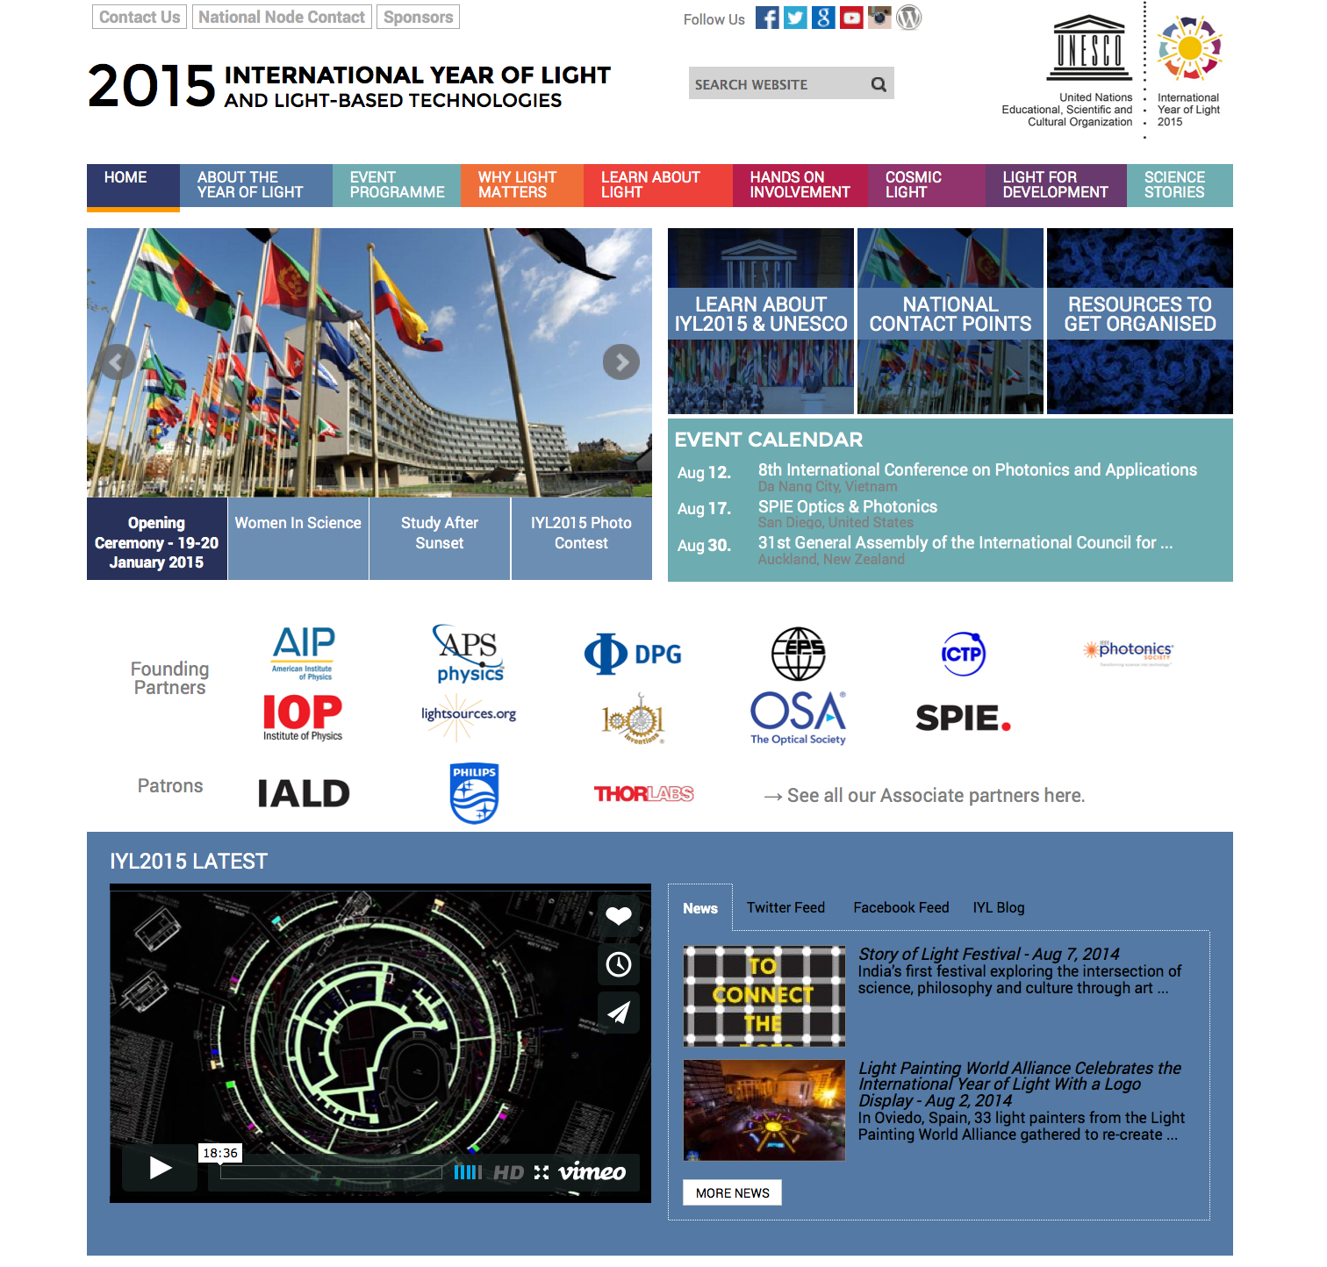

Slide 23
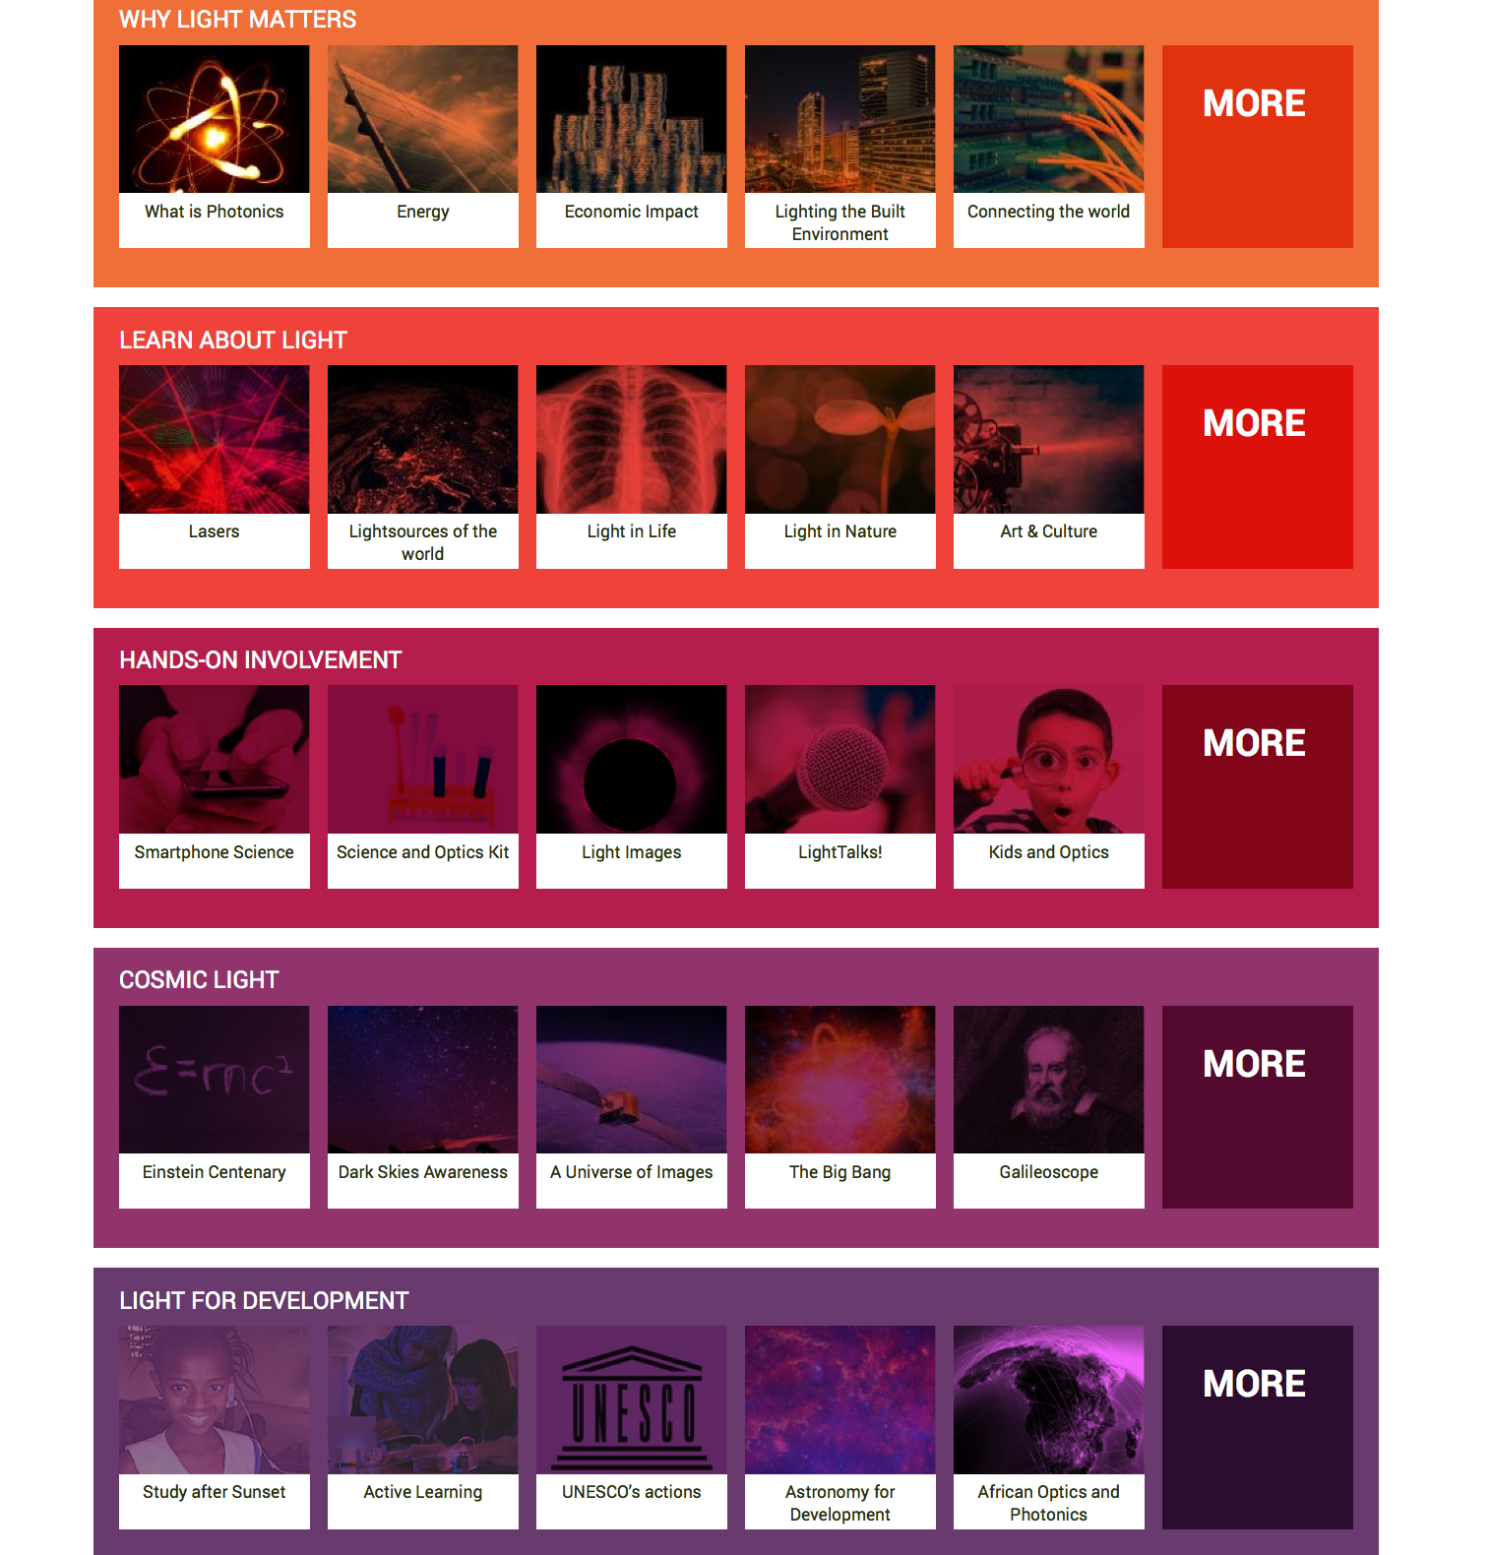

Slide 24

Invisible part of spectrum

Slide 25
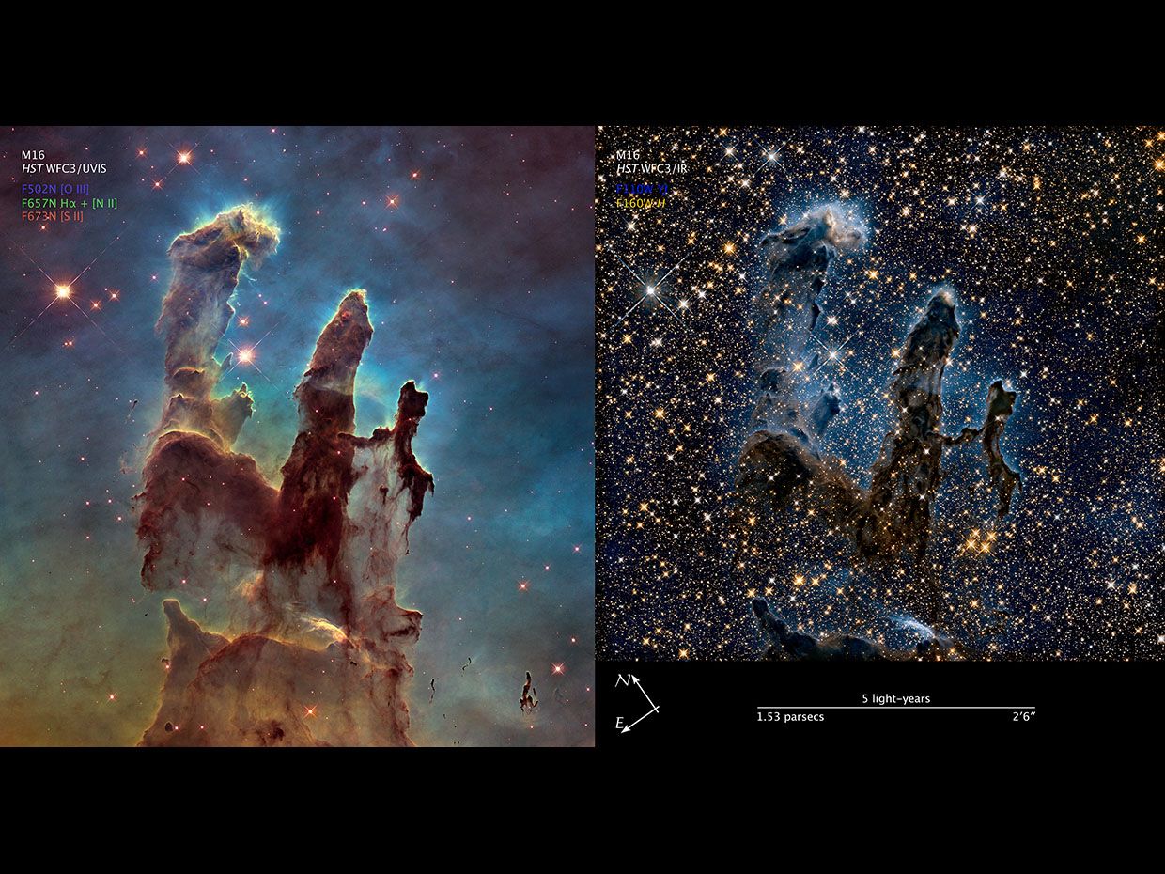

Slide 26
Key messages of Cosmic Light
Photons are light particles - electromagnetic messengers
The Universe is permeated by light
Our eyes are carefully tuned to the sunlight through evolution
The electromagnetic spectrum is much more than visible light
Telescopes on ground and in space capture the elusive photos in different wavelengths
The colour images we get from the telescopes represent a kind of hyper-realistic view of the Universe - far more sensitive than what our eyes can see, but not less “true” for that reason.
Light pollution must be reduced to preserve our view of the Universe, and to save energy

Slide 27
Why international year?
Common goals
Easy to attract unusual target group
Thousands of shared resources
Focal point to drive the community for doing outreach activities
Why?

Slide 28
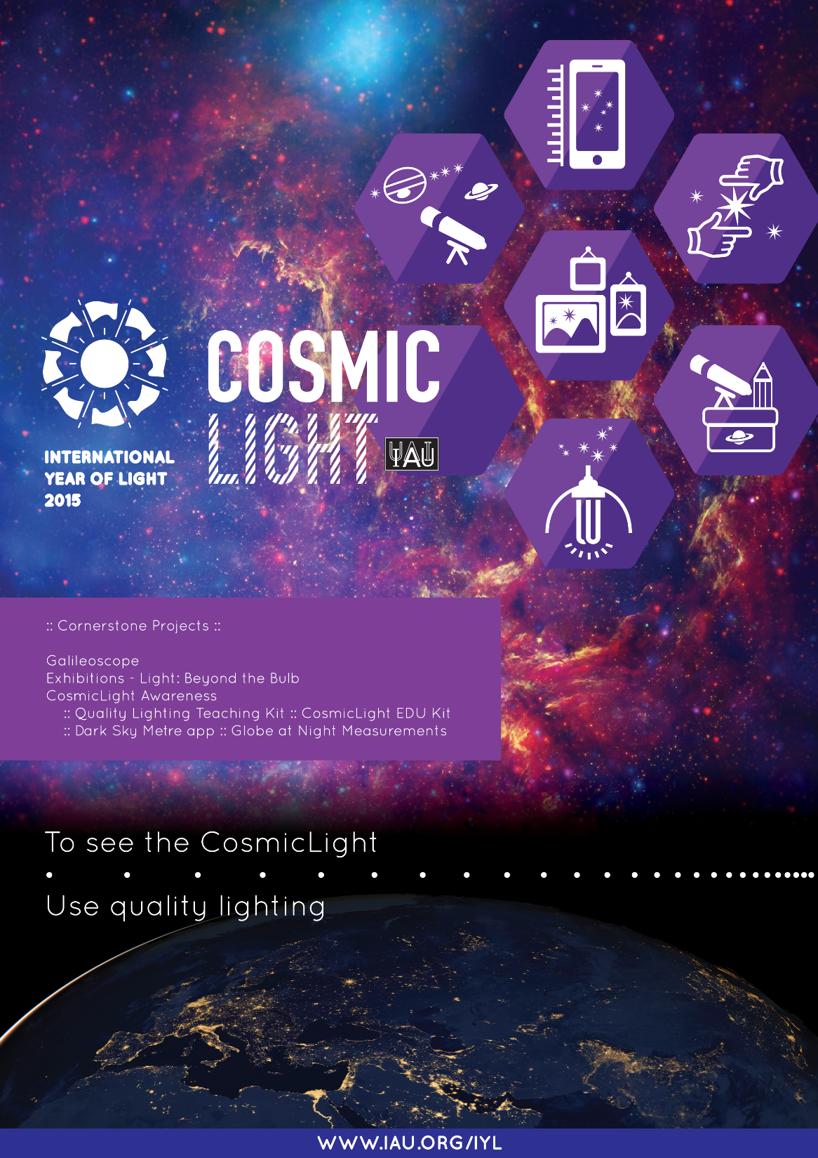
How?

Slide 29
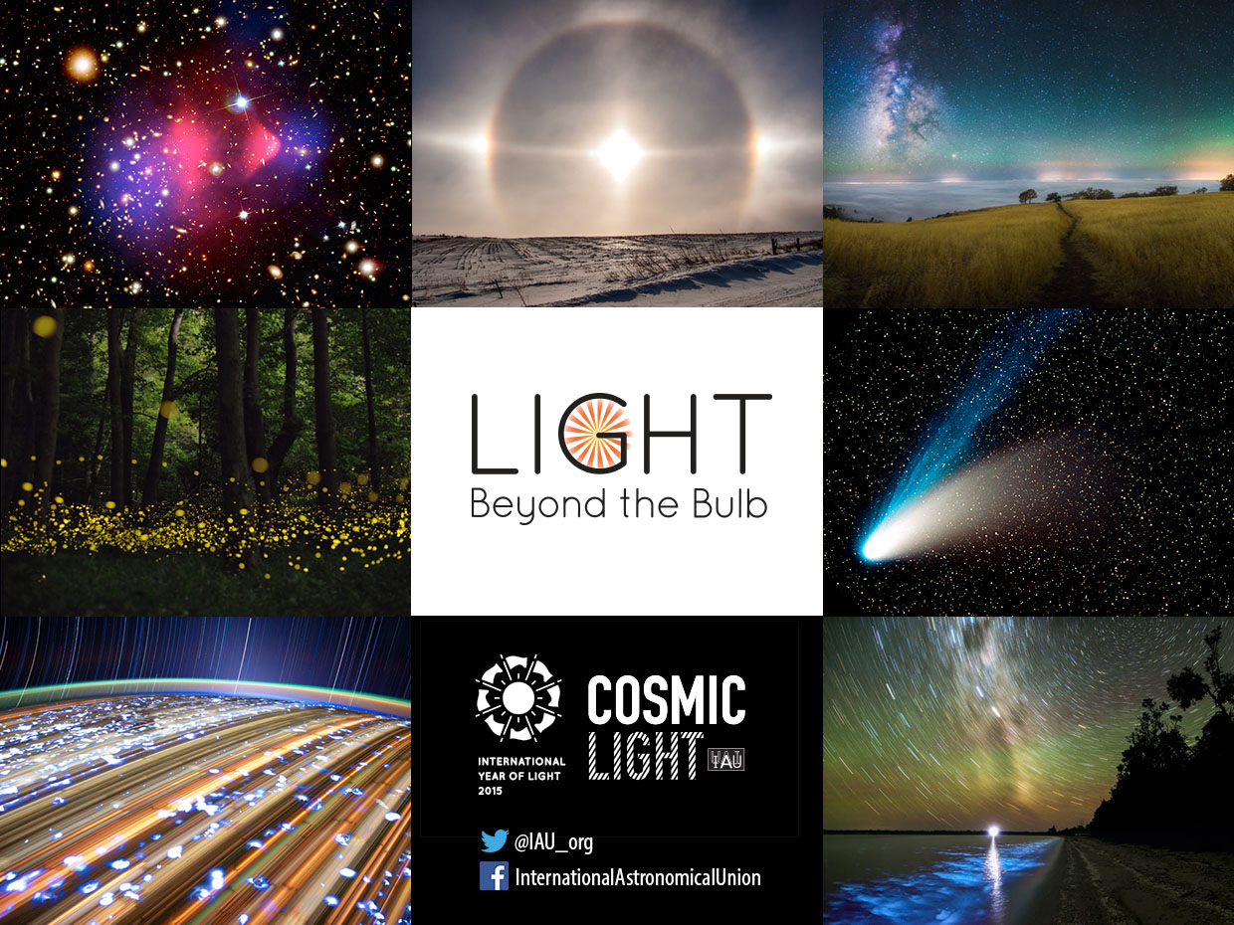

Slide 30
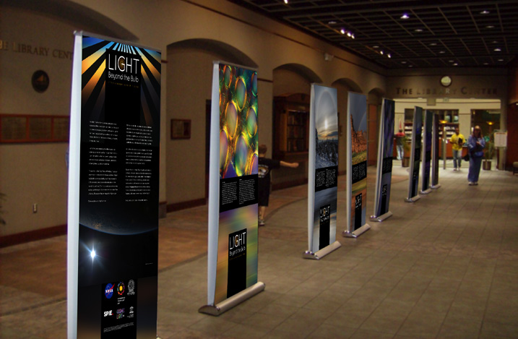
Light: Beyond the Bulb
Large Scale Exhibition
http://lightexhibit.org
Chair: Kimberly Kowal Arcand

Slide 31
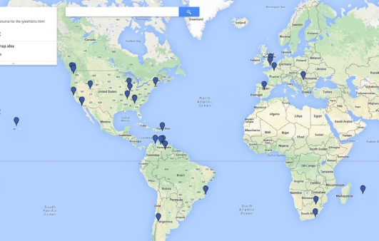

Slide 32
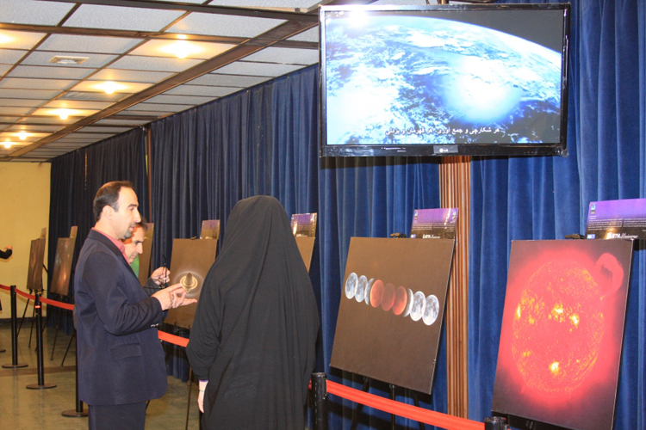
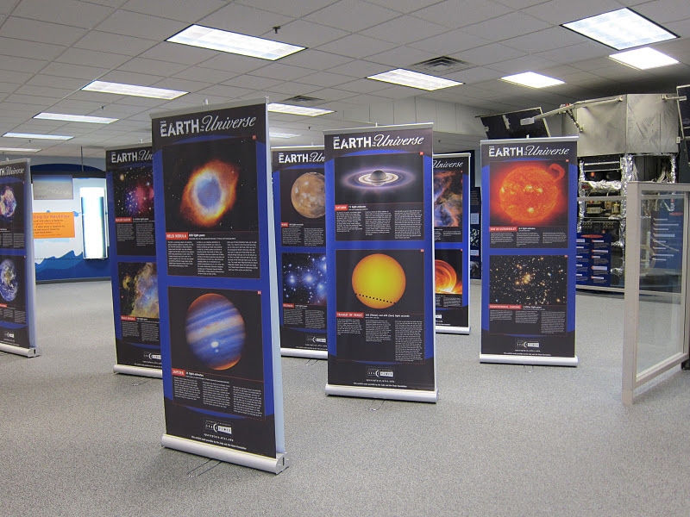
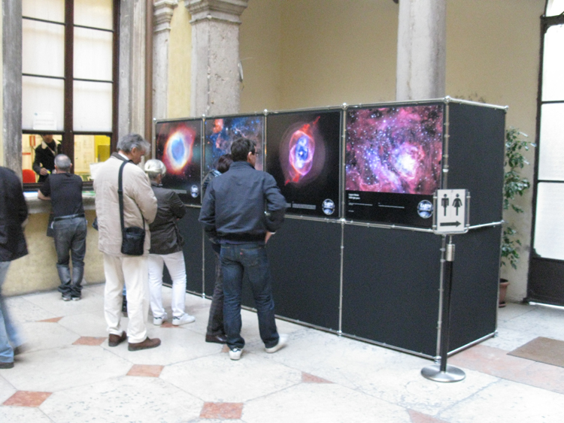
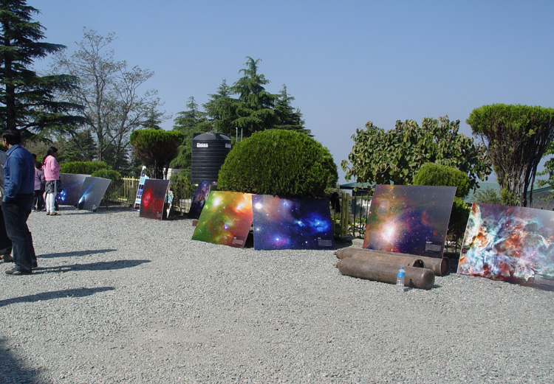

Slide 33
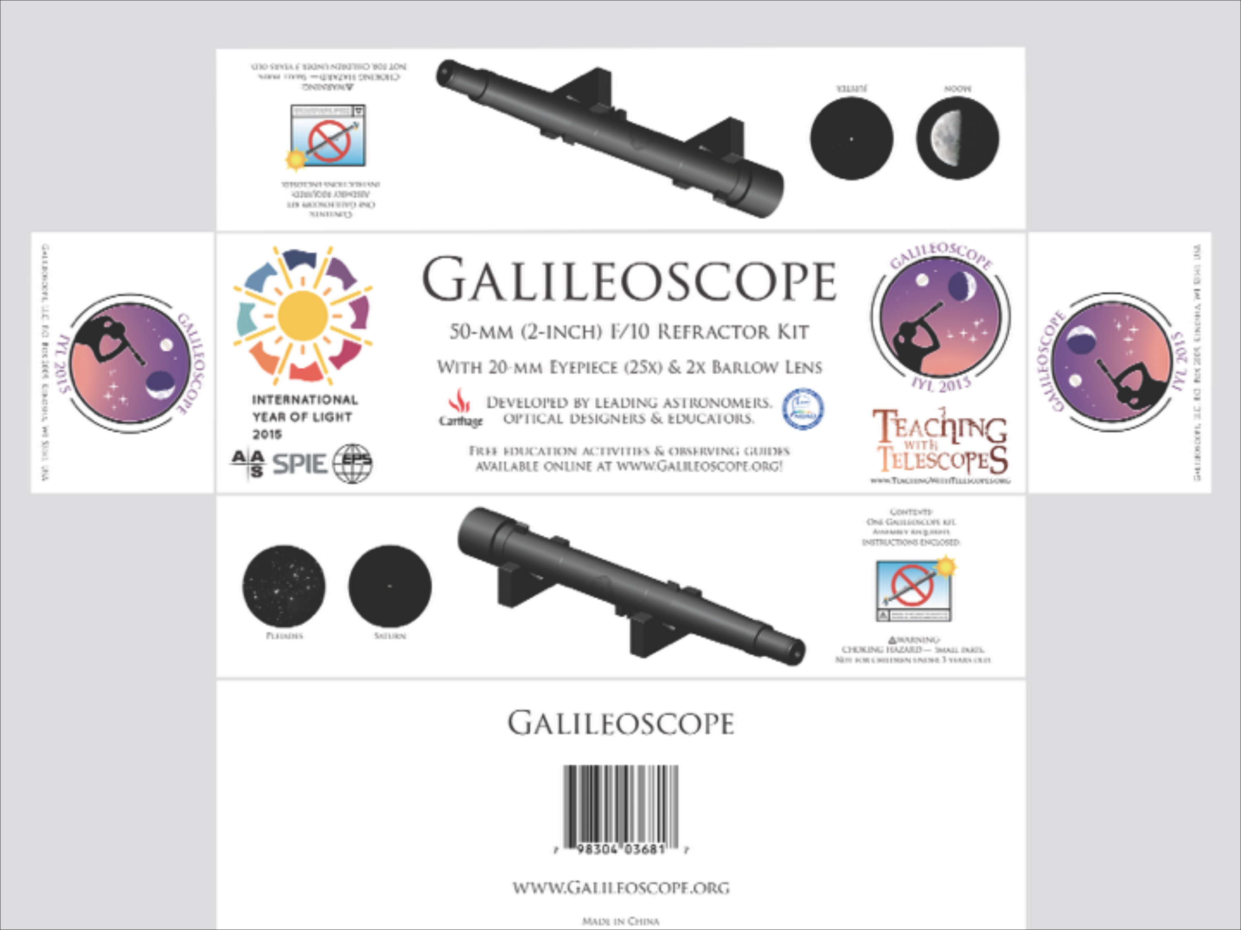
The Galileoscope
Good quality telescope at a reasonable price
Chair: Douglas N. Arion
http://galileoscope.org/

Slide 34
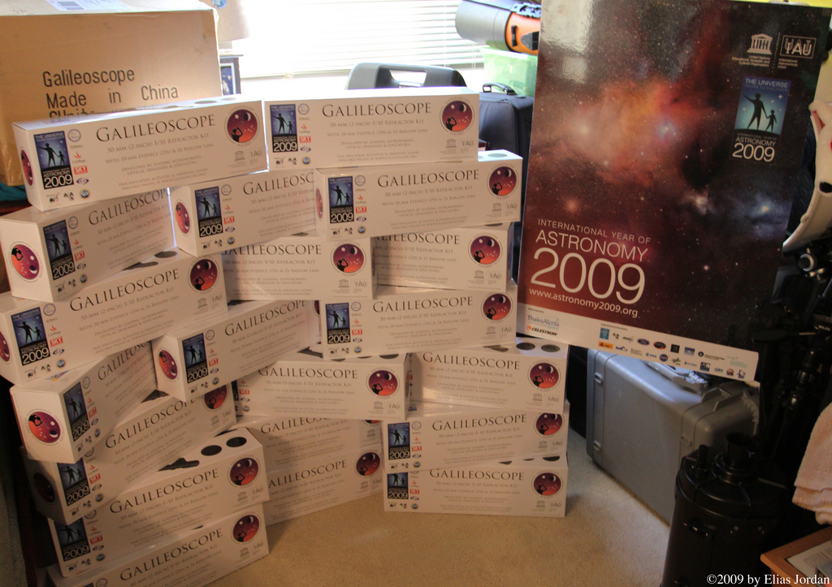
A shipment of Galileoscopes arrives, USA, 23.11.09
Notes:
Event: A shipment of Galileoscopes arrives
Date: 23 November 2009
Place / country: USA
Photographer: Elias Jordan
URL: http://www.flickr.com/photos/eliasjordan/4129397196/in/pool-iya2009

Slide 35
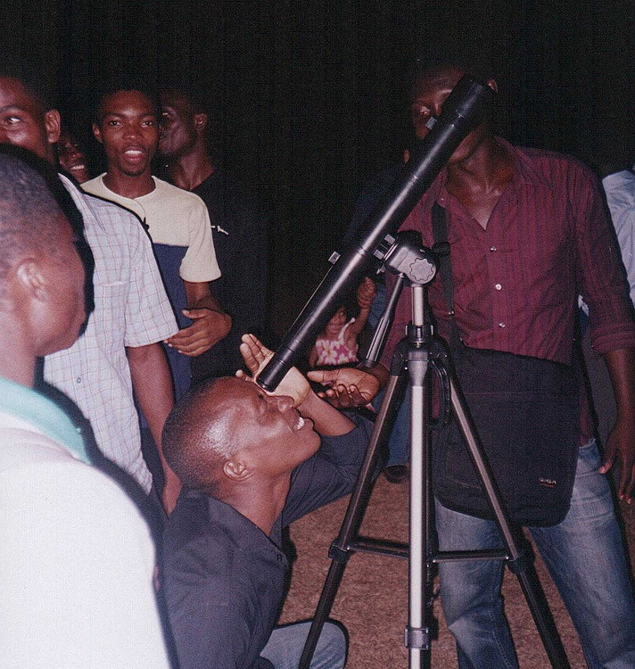
Observing the moon with a Galileoscope, Ghana, 05.10.09
Notes:
17 countries have been awarded grants intended to stimulate astronomy activities in areas that include astronomy education workshops for teachers, the recording and preservation of indigenous astronomy knowledge, the production of school astronomy education resources in local languages and many more.

Slide 36
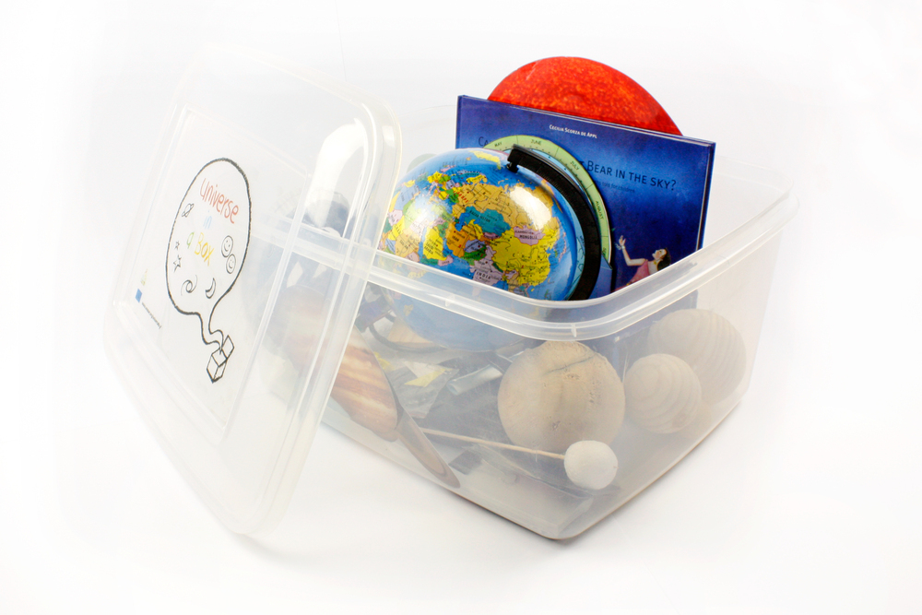

Cosmic Light Awareness
Education Kit, Dark Sky Awareness, DarkSky Apps, Online Tutorials
PI: Rosa Doran
CoI: Pedro Russo
Chair: Rosa Doran
Cosmic Light EDU kit
Online Tutorials

Slide 37
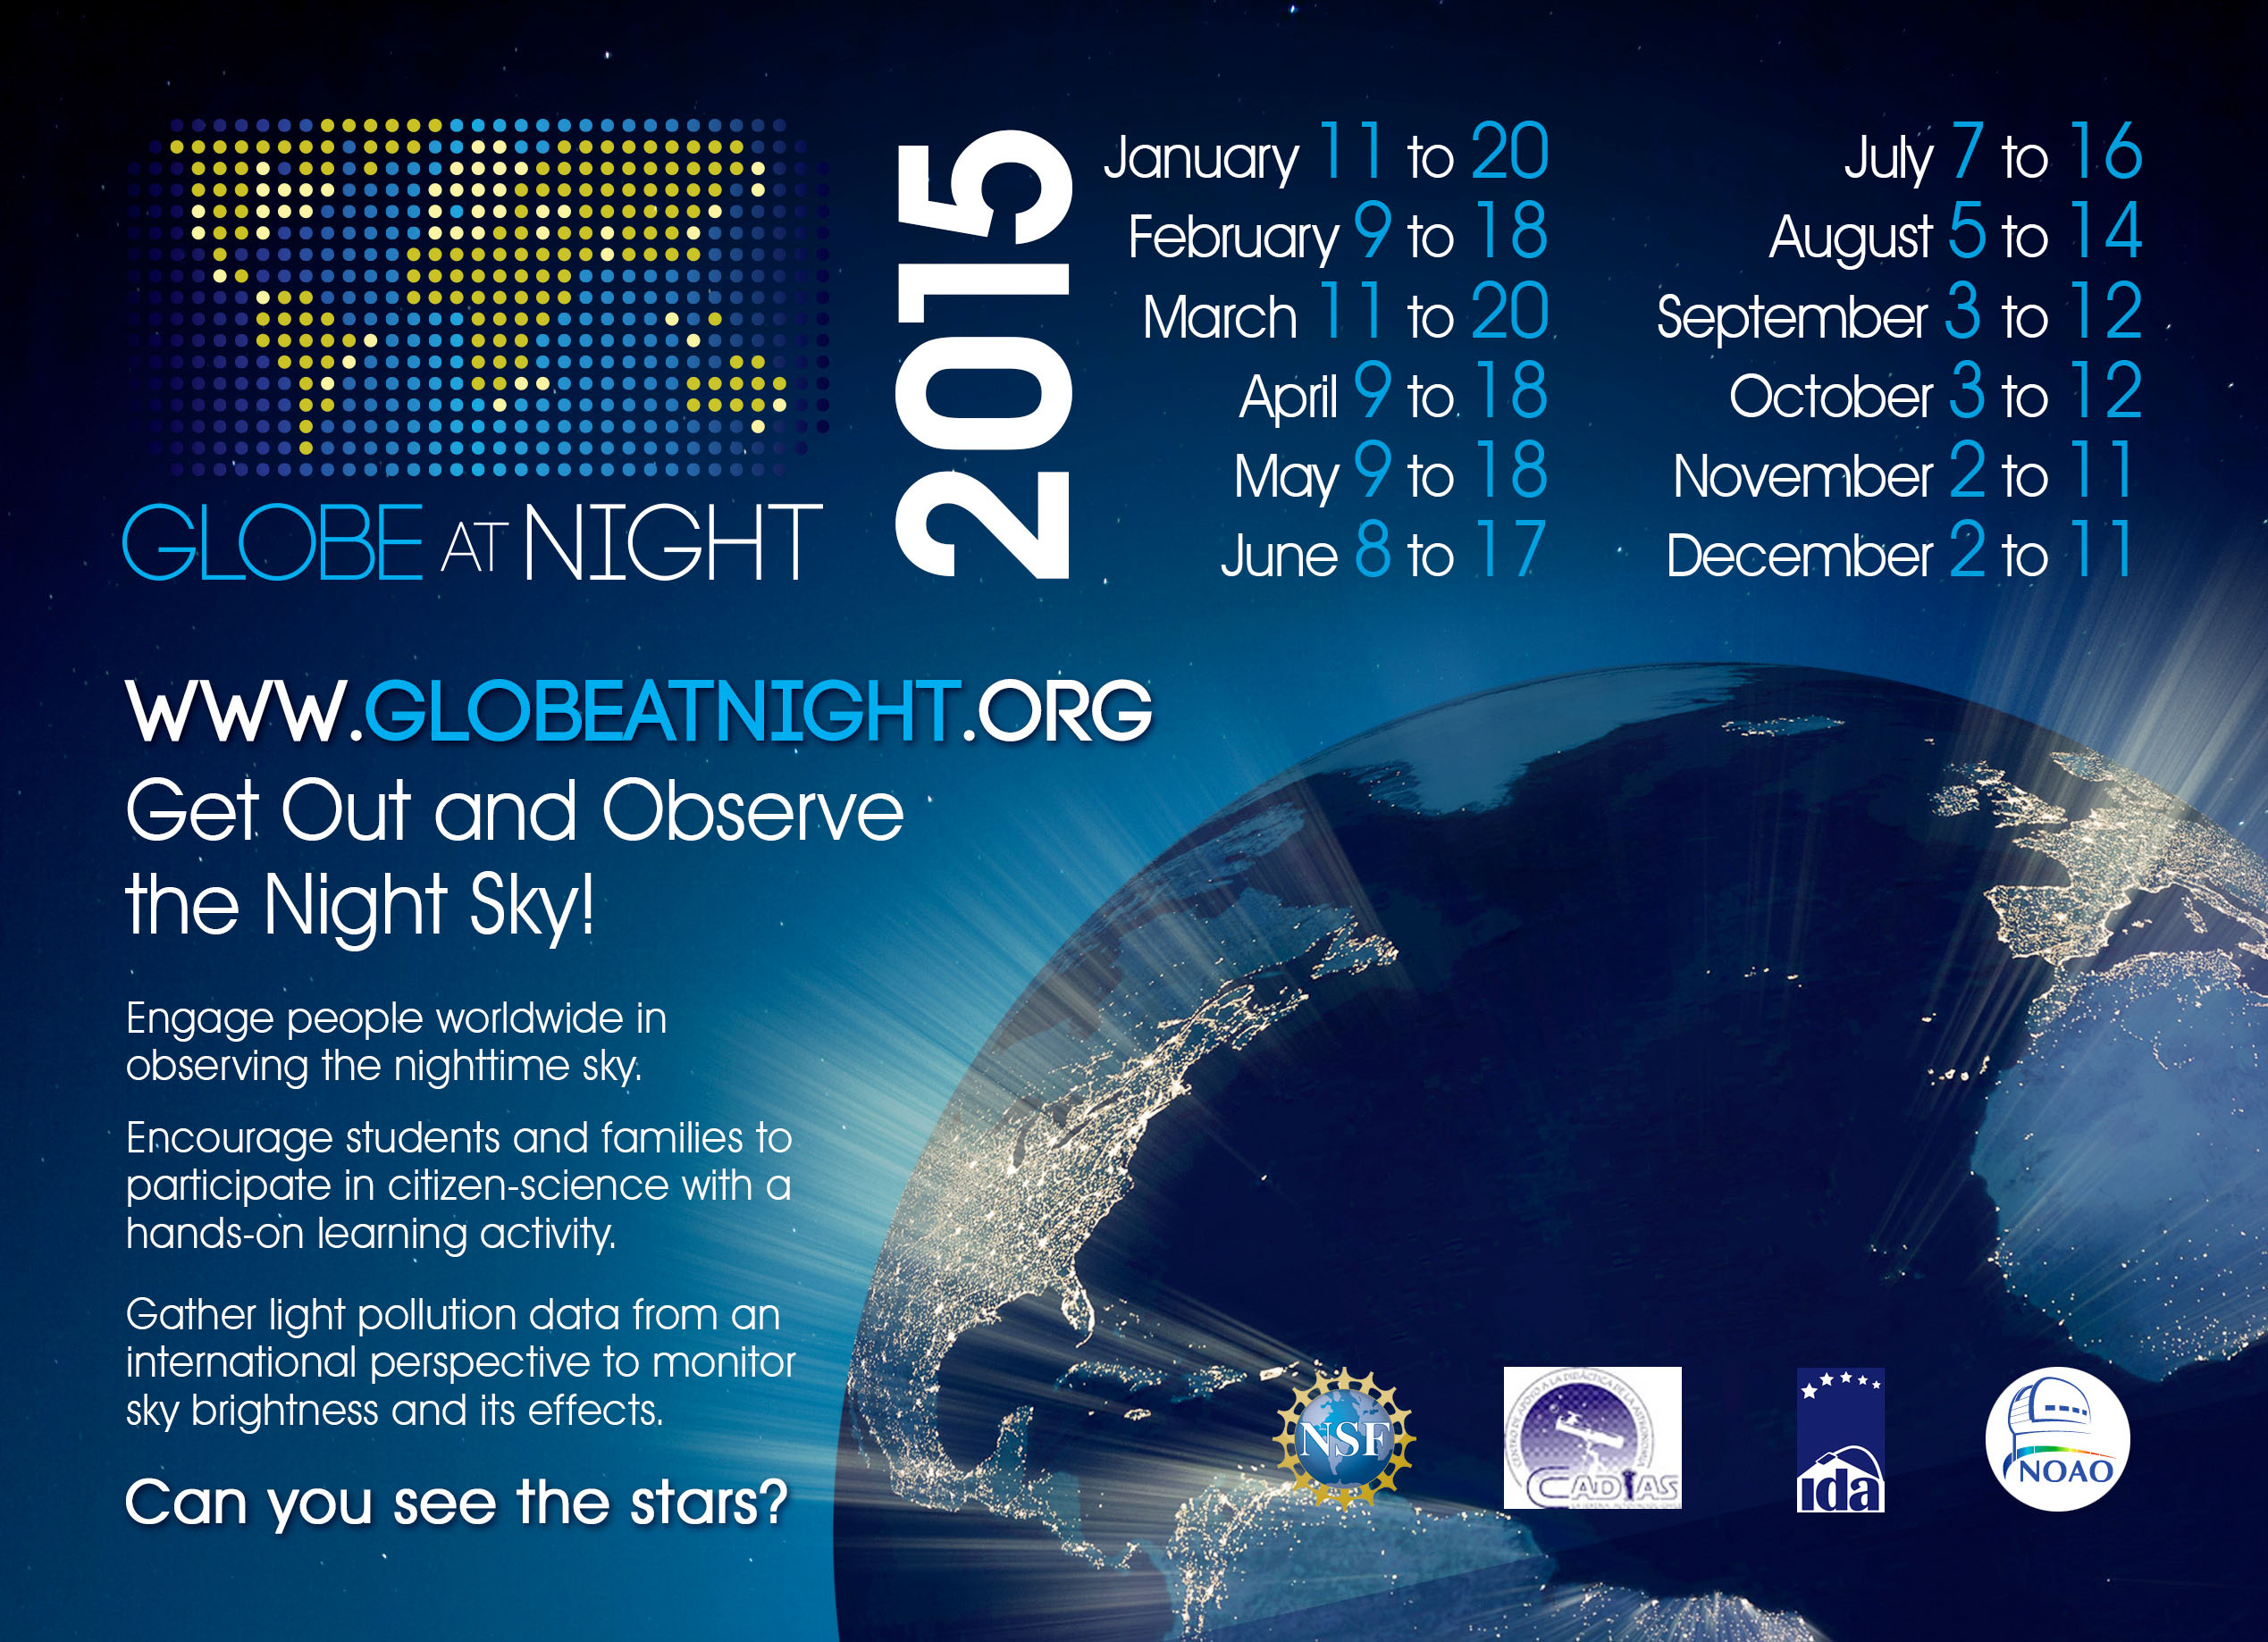

Slide 38
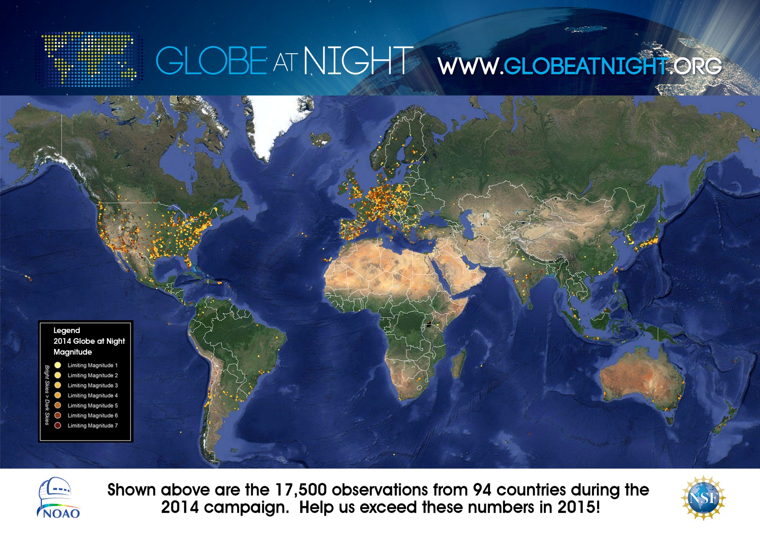

Slide 39
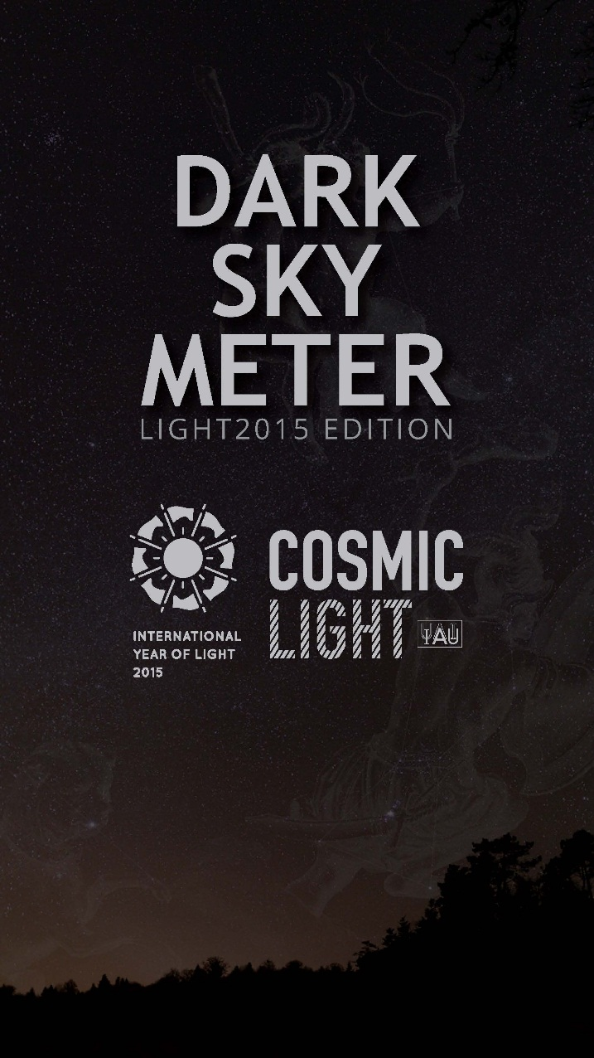
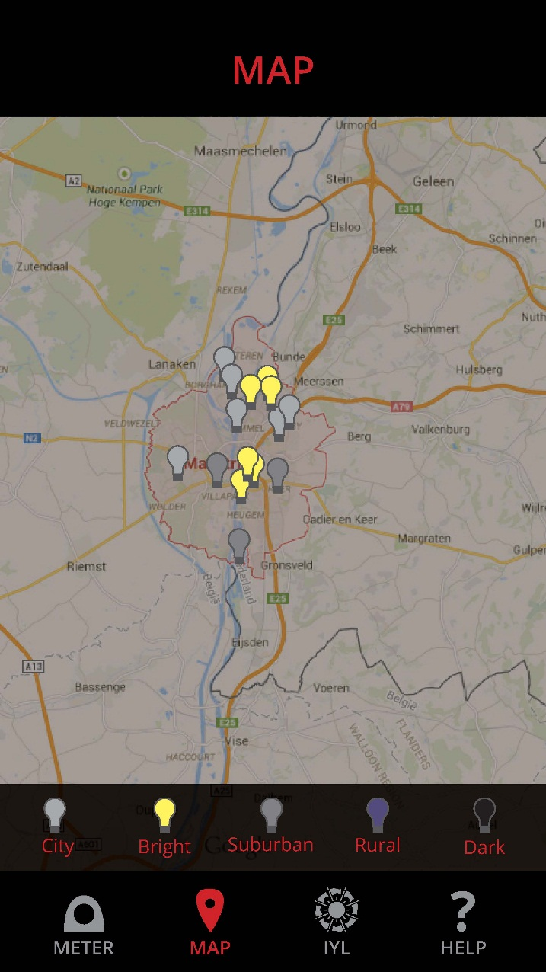
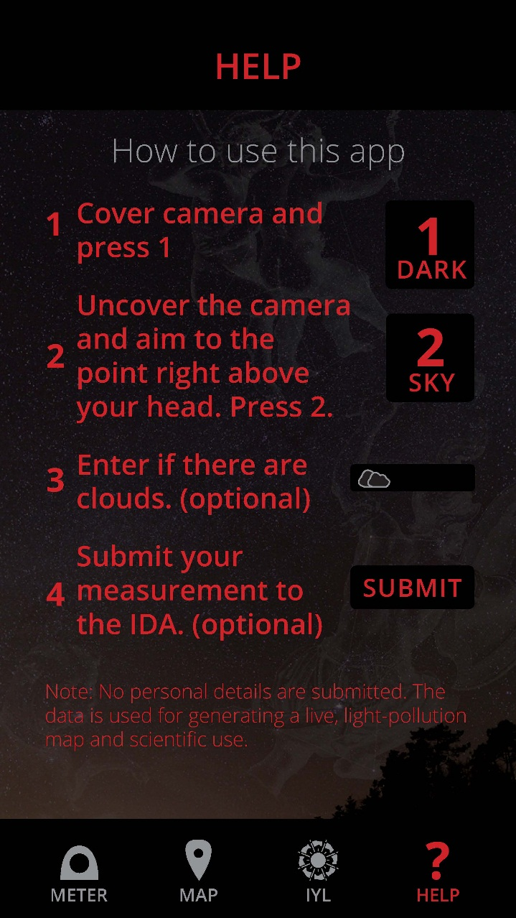

Slide 40
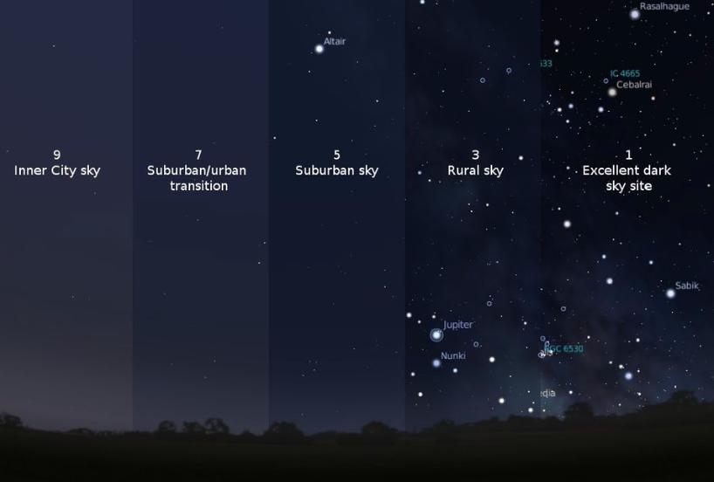

Slide 41
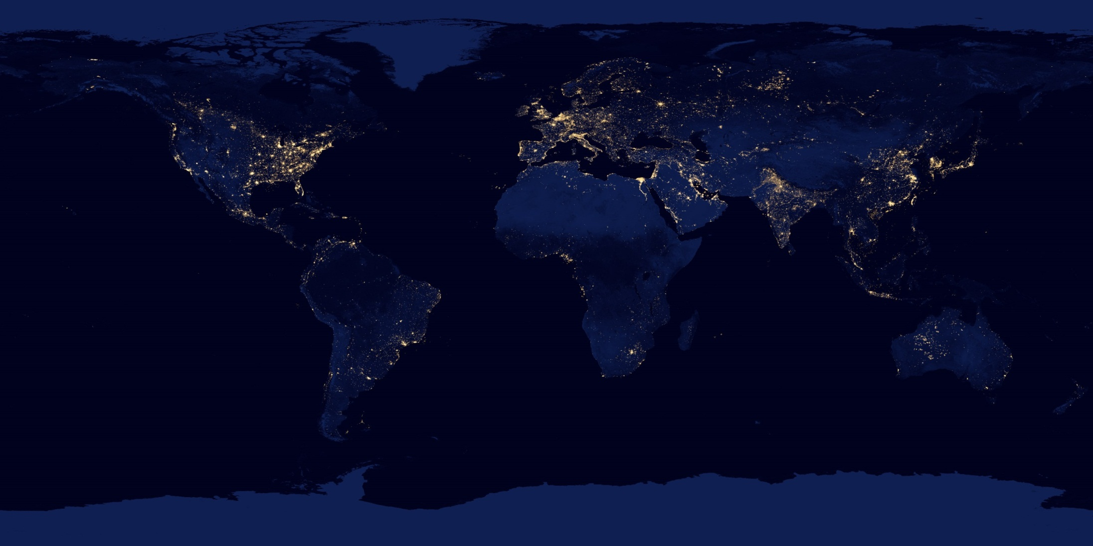

Slide 42


Slide 43
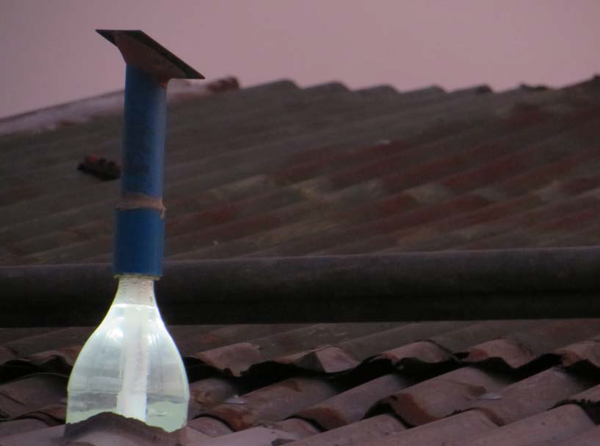
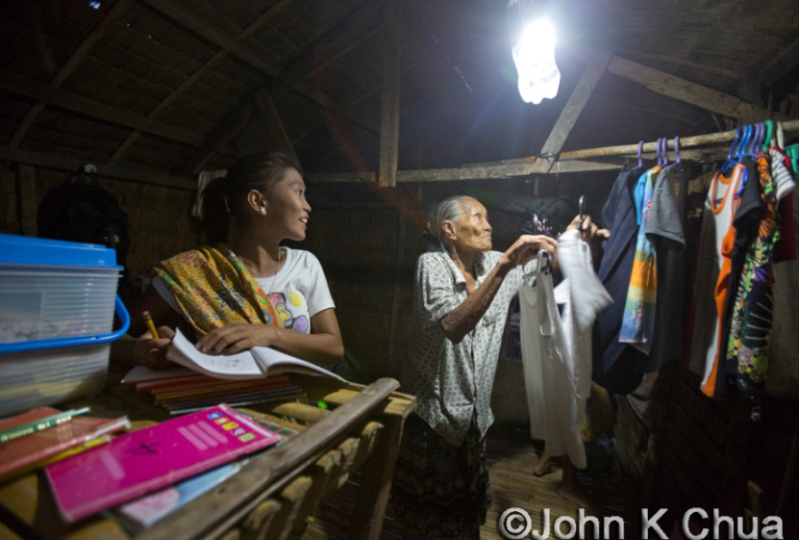
literoflight.org
The Liter of Light redesigns solar lighting for developing countries; this simple, two-step solar lighting technology creates local jobs, teaches green skills, and empowers local communities.
Using recycled plastic soda bottles, 10 milliliters of bleach, and distilled water, the bottle is placed through galvanized steel sheet roofs common to many developing countries.
Sunlight refracts through the bottle and bends to light the space below with 55 watts of brightness, saving an average of US $10 in electricity bills a month and 200 kilos of carbon a year.

Slide 44
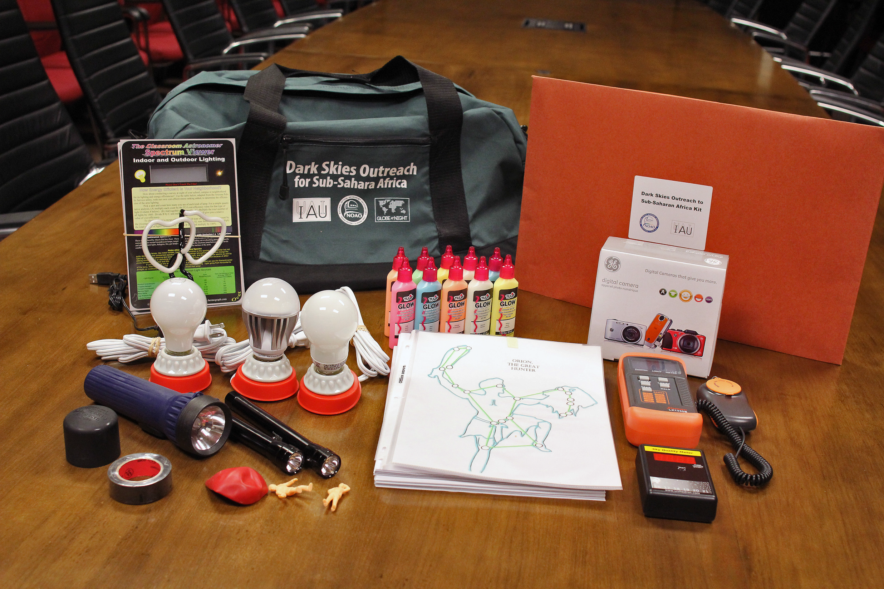
Quality Lighting Teaching Kits

Slide 45
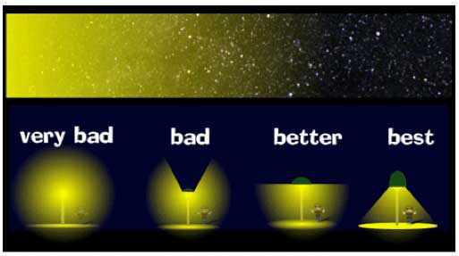
Shielding

Slide 46
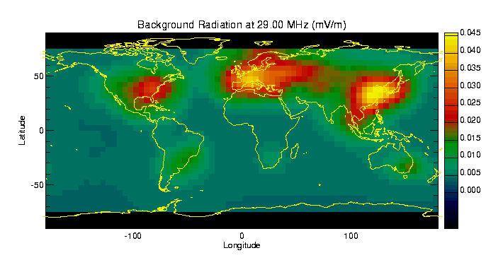
“Light Pollution” of Radio Interference

Slide 47
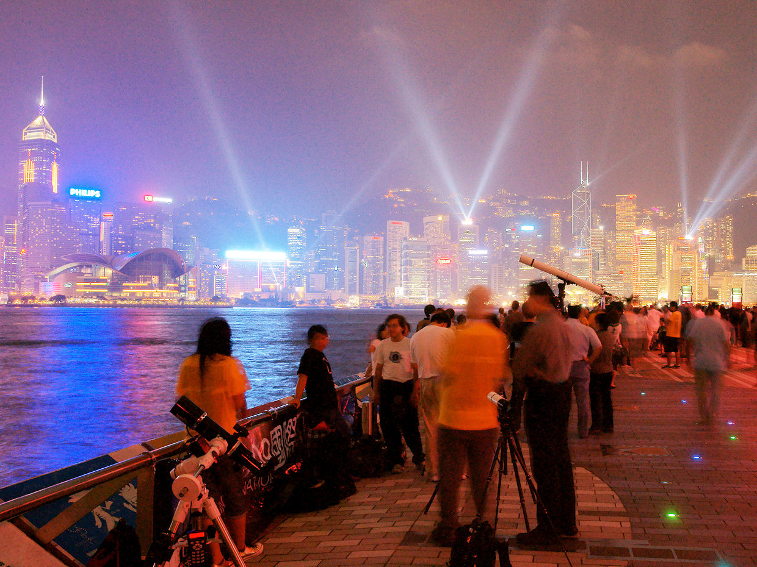
Light Pollution for Policy Makers
Credit: Sze-leung Cheung

Slide 48
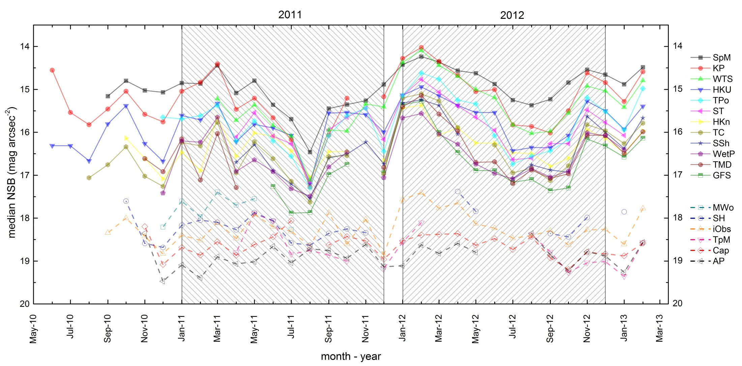
Monthly variation of night sky brightness across HK sites
Median value of NSB reading taken over 1 month
darker in summer
brighter in spring
Ranking of different sites, reflecting ambient lighting usage, stays roughly the same.
Monthly variation at a particular site due mostly to meteorological or atmospheric factors such as cloud or particulate concentration.

Slide 49
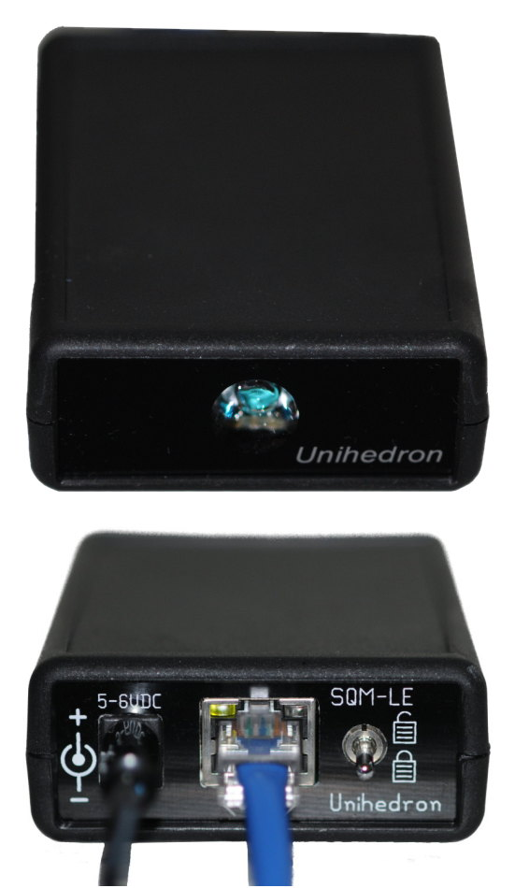


Set up Global Monitoring Stations
Sky Quality Meter - LE
400 USD each

Slide 50

100 Hours of Light
Friday to Monday / 25-28 September 2015
Friday 25 September Researchers’ Night in Europe
Monday 28 September Total Lunar Eclipse

Slide 51



Global Open Lab Day (GOLD)
9-25 May 2015, any date, any time, any where

Slide 52


www.iau.org/iyl

Slide 53


Slide 54






You can make it happen

Slide 55



IYL Nodes
Communication Channels
IAU NOCs
Project PIs
IAU Office for Astronomy Outreach

Slide 56

IAU Directory for World Astronomy
directory.iau.org

Slide 57

Contact us
outreach@iau.org www.iau.org/public
facebook.com/InternationalAstronomicalUnion
Twitter: @IAU_org

