Slide 1
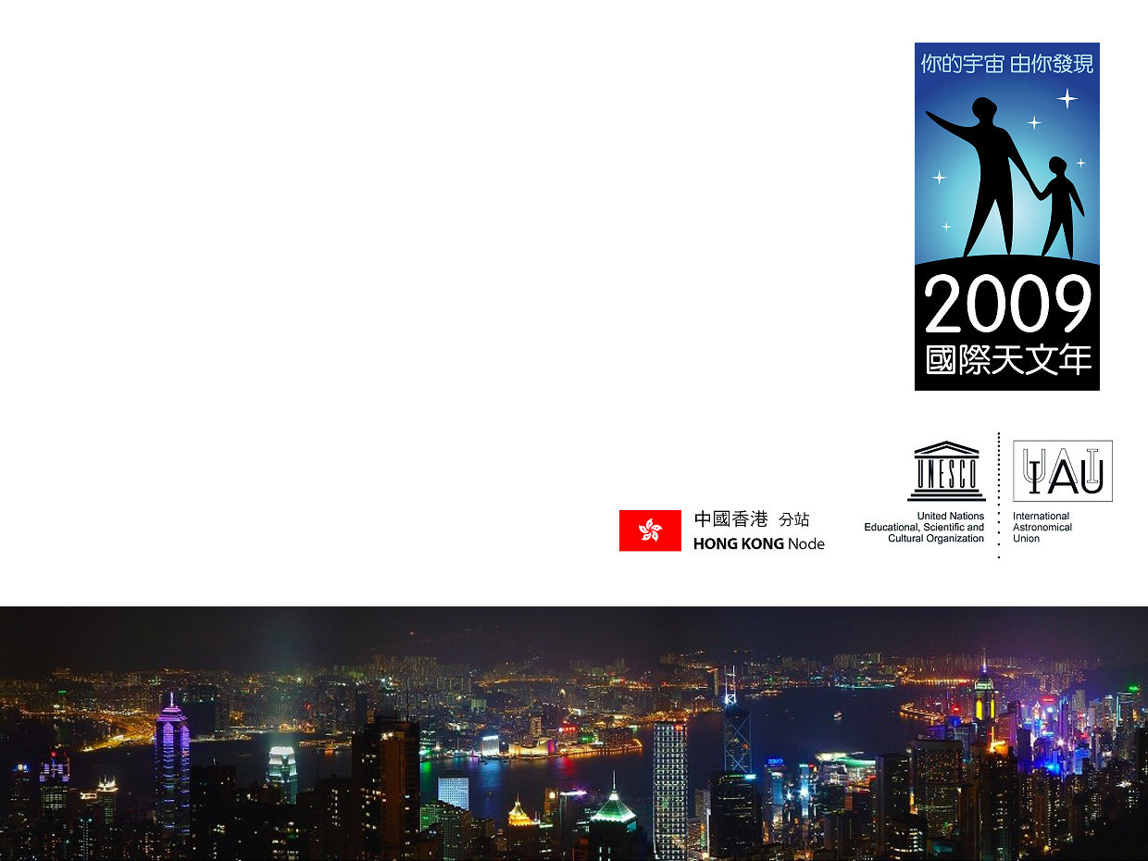

“Dark Sky” Actions in Hong Kong
Sze-leung Cheung
International Outreach Coordinator
Office for Astronomy Outreach
International Astronomical Union

Slide 2
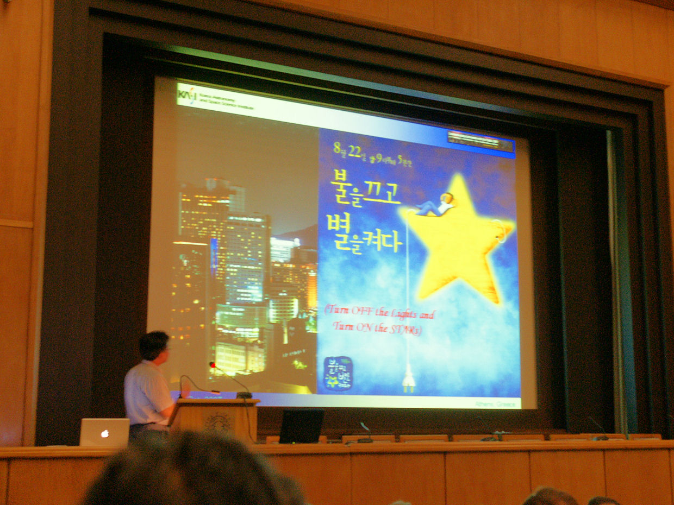
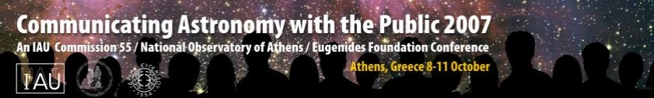
Back in CAP2007 in Athens
Credit: Sze-leung Cheung

Slide 3
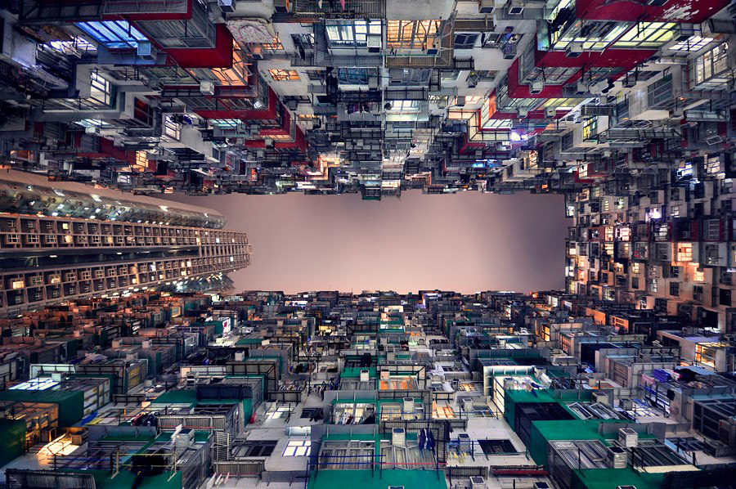
Population: 7 million
Size: 1000 sq. km

Slide 4
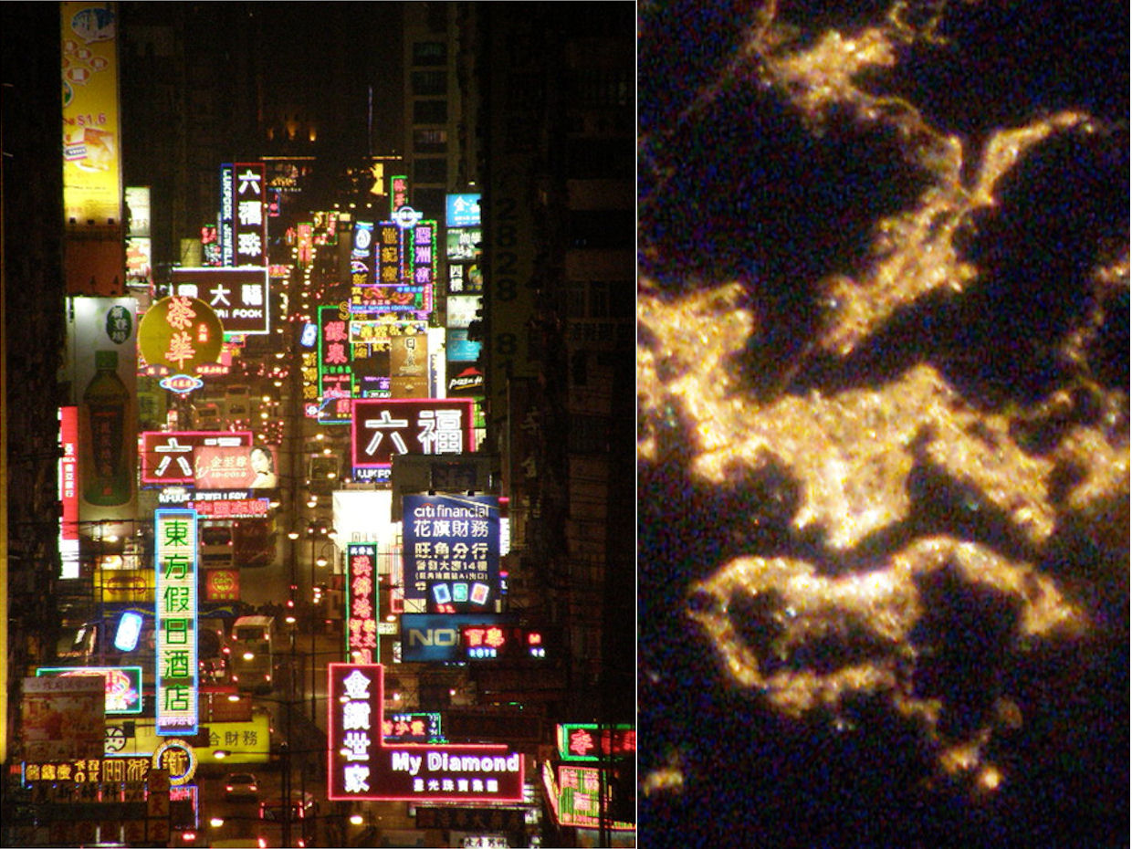
Nathan Road
Credit: Friends of Earth (Hong Kong)

Slide 5
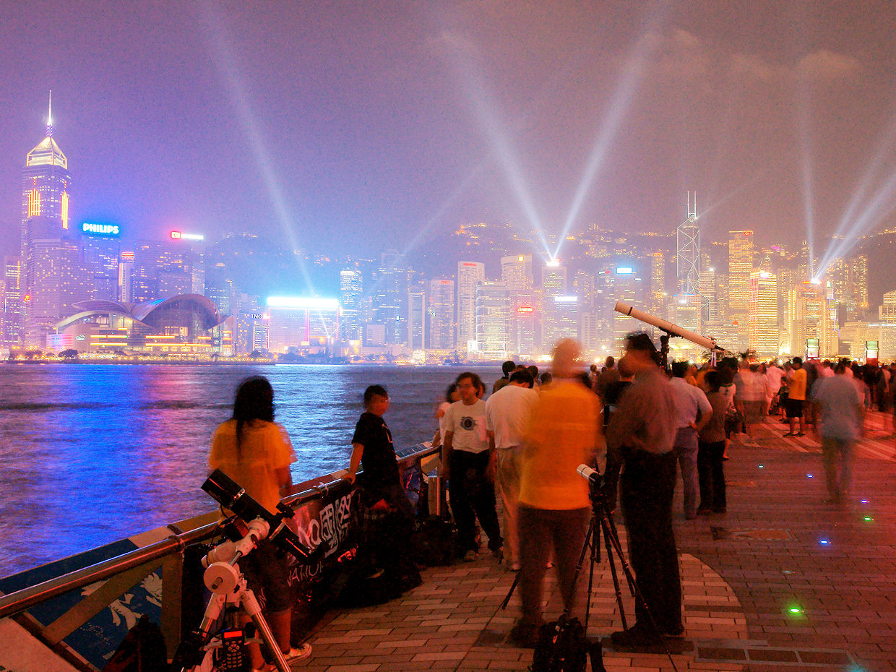
Mission and goals
More people understand the importance of light pollution (9/10)
Government legislation on the lighting control (6/10)
Establish a Dark Sky Reserve in Hong Kong (1/10)
Credit: Sze-leung Cheung

Slide 6
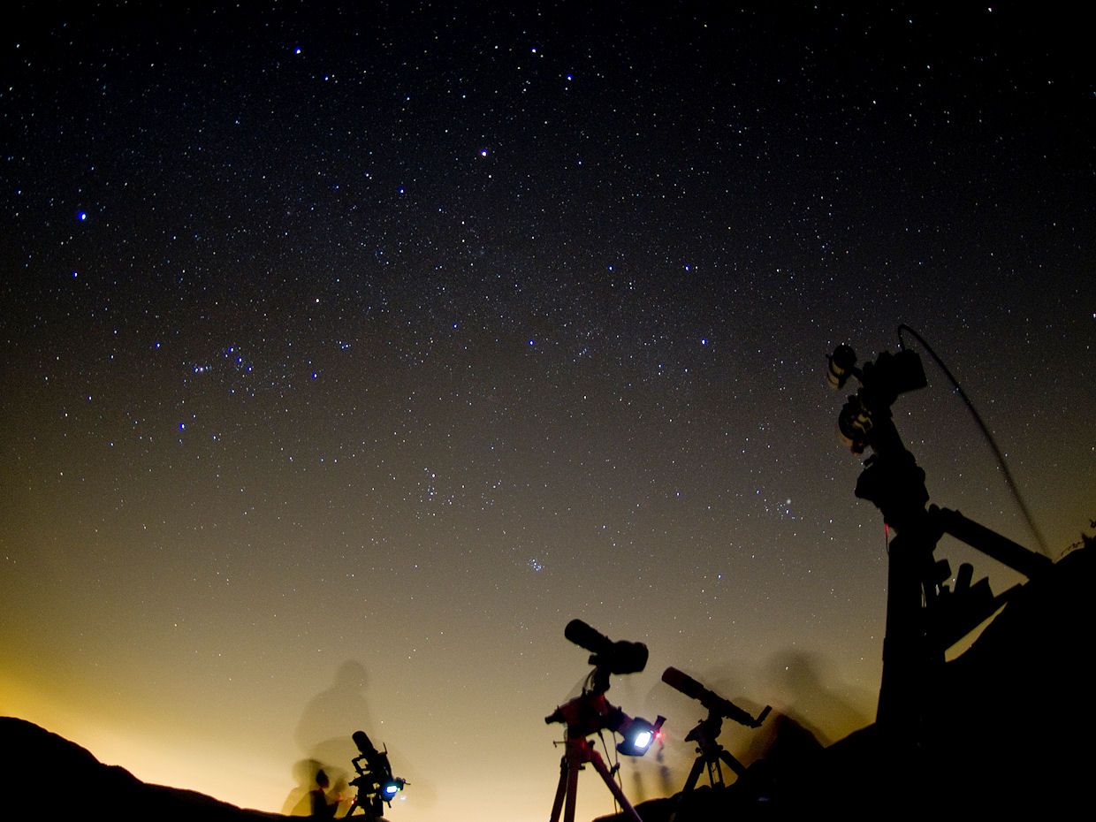
Stargazing under the brightest city
- the IYA2009 actions
Credit: Ho-keung Hui

Slide 7
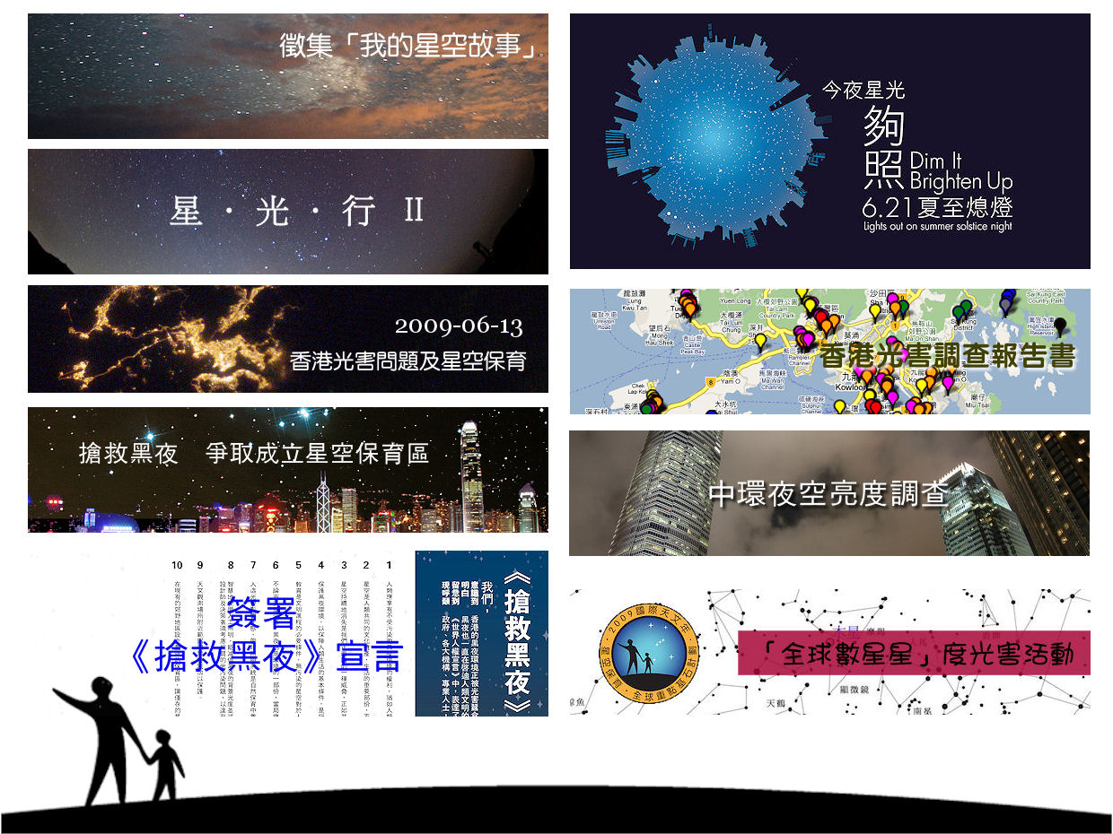
Collections of "My Starry Memories"
Star . Light . Tour II
Light Pollution IYA Public Lecture
Hong Kong Light Pollution Survey
Save Dark Sky, Establish Dark Sky Reserve
Central Sky Brightness Investigation
Signing of the "Dark Sky Declaration"
World Wide Star Count

Slide 8
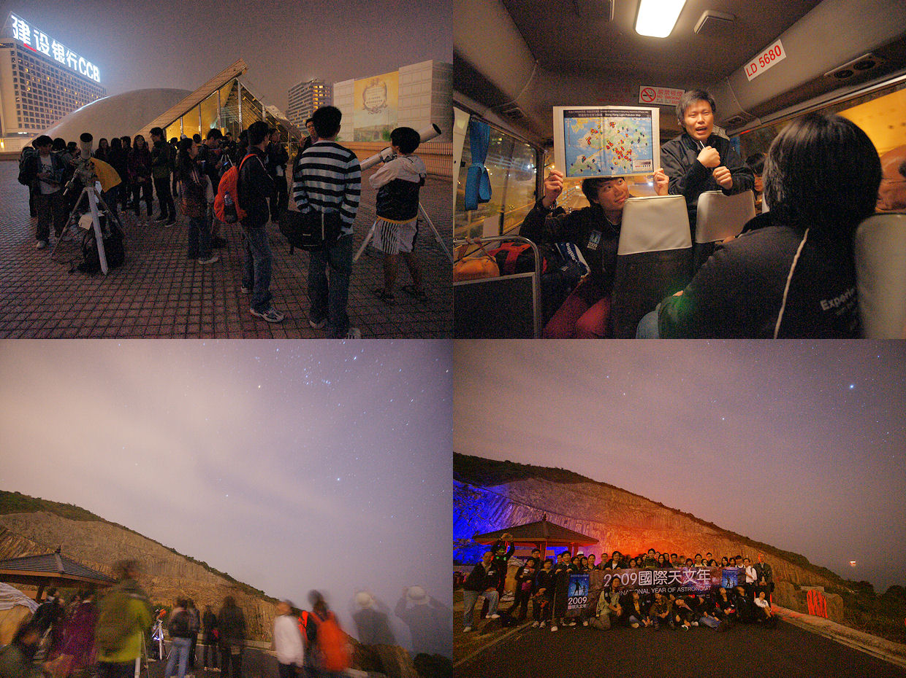
Stargazing in the brightest and darkest area in ONE night
60 quota but 1200 people applied
Bring reporters to join the event
Star(gazing) . Light(Pollution) . Tour
Credit: Sze-leung Cheung

Slide 9
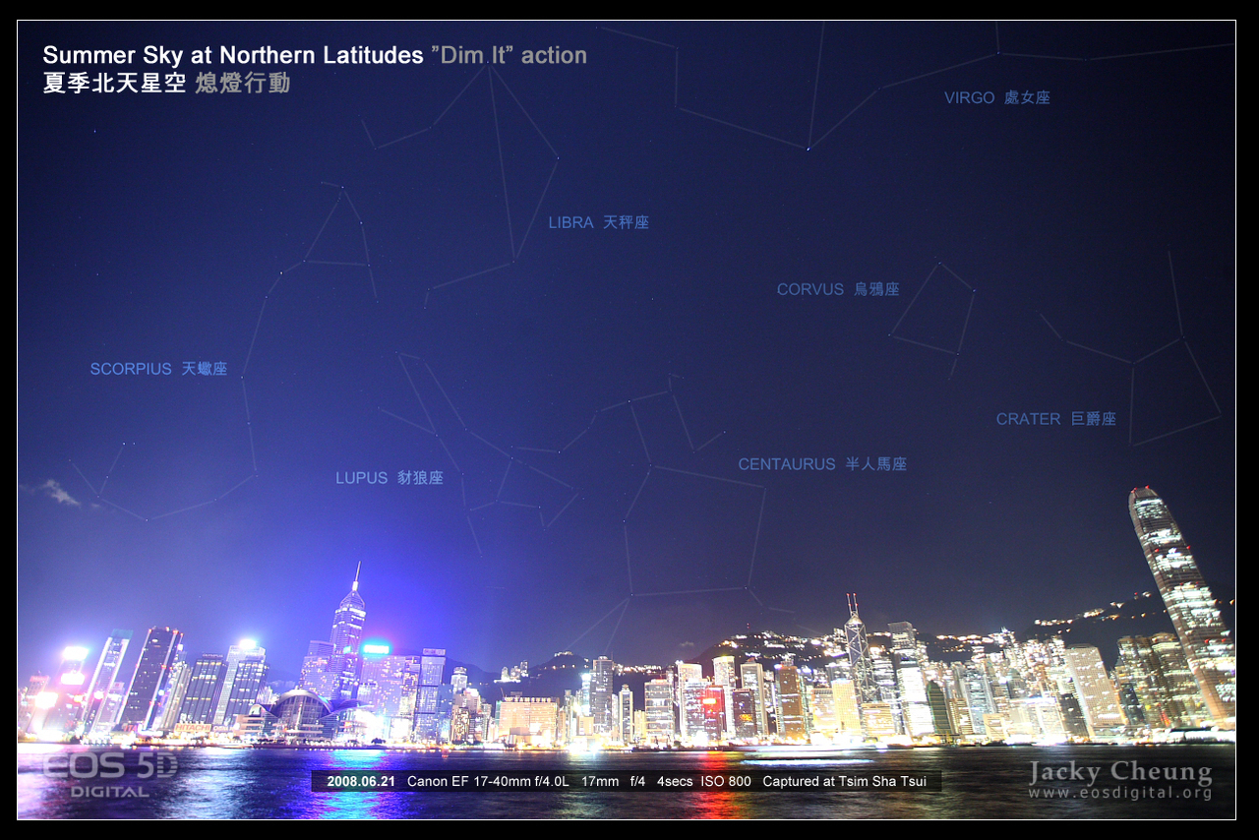
The “Dim It” Movement

Slide 10
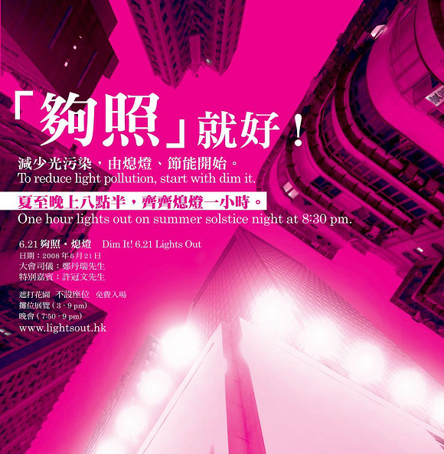

[Dim It] Dictionary Dim It Intonation: [dIm][It] Meaning: [Verb] Sufficient illumination for one's needs;
it should not be wasted, nor should it disturb. [Noun] Dim It campaign has four major
objectives: (1) to arouse public awareness of
light pollution; (2) to encourage businesses to use lightings in a proper way; (3) to advocate regulating light pollution and light nuisance; (4) to motivate the public to reflect upon their materialistic lives. Motto: Dim it!

Slide 11
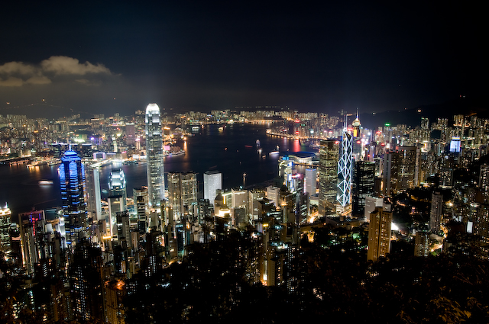
Jun 21, 2008 Before “Dim-it”

Slide 12
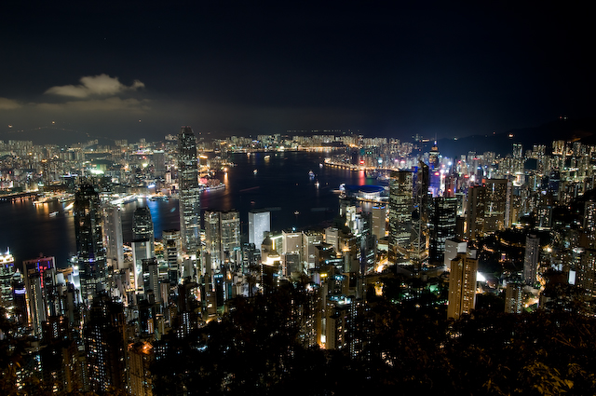
Jun 21, 2008 After “Dim-it”

Slide 13
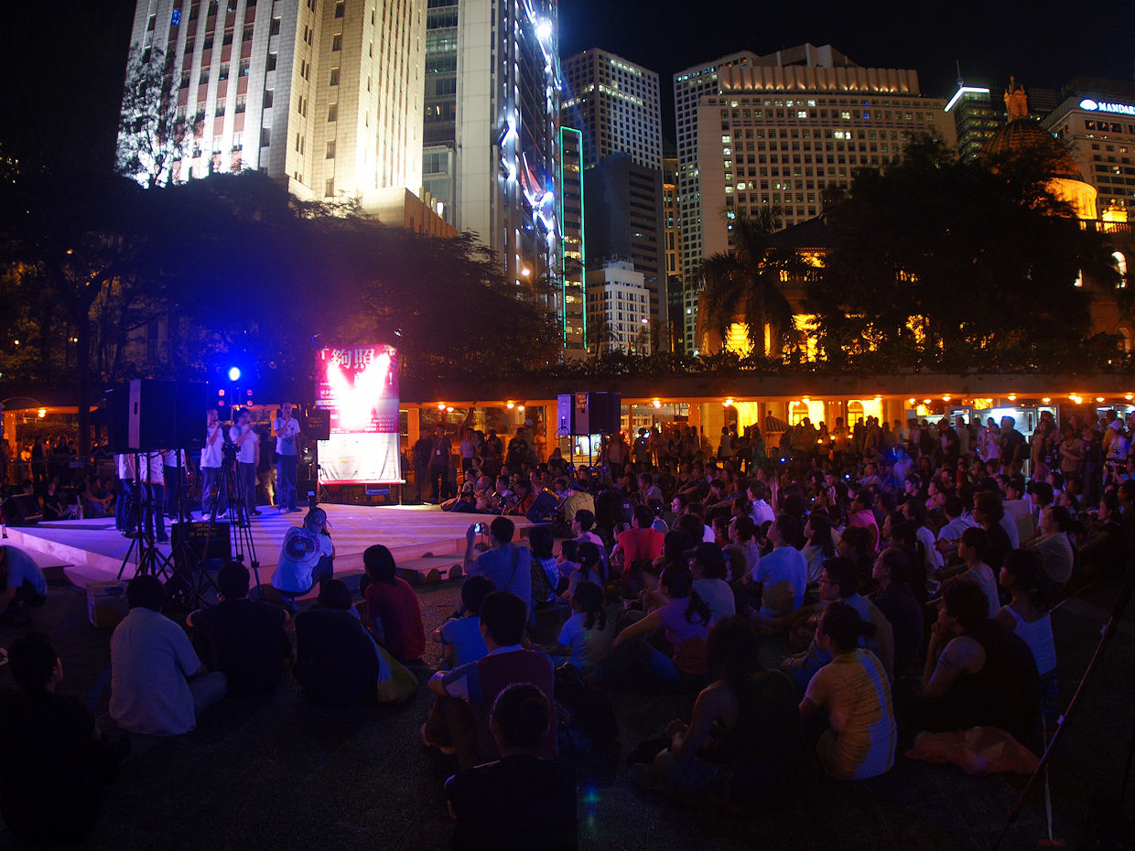
"Dim-it" Event 2008
142 landmark buildings and advertisement signs dimmed their lights for an hour
The 1st mass scale lights off event ever successful
Credit: Sze-leung Cheung

Slide 14
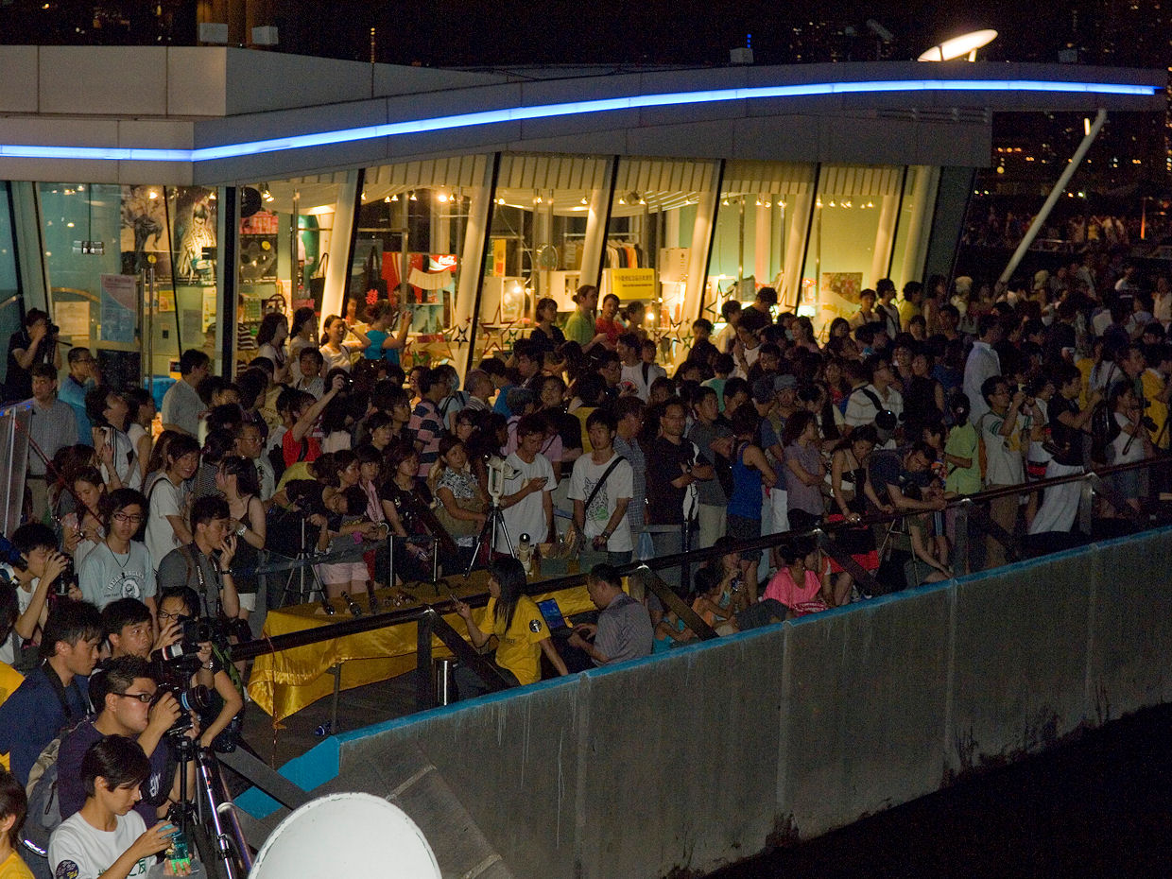
"Dim-it" Event 2009
3500 landmark buildings and advertisement signs turned off their external lightings for two hours
Over 50,000 people presented for the count down
Over 2,000,000 people were reached by media
Credit: Kenneth Choi

Slide 15
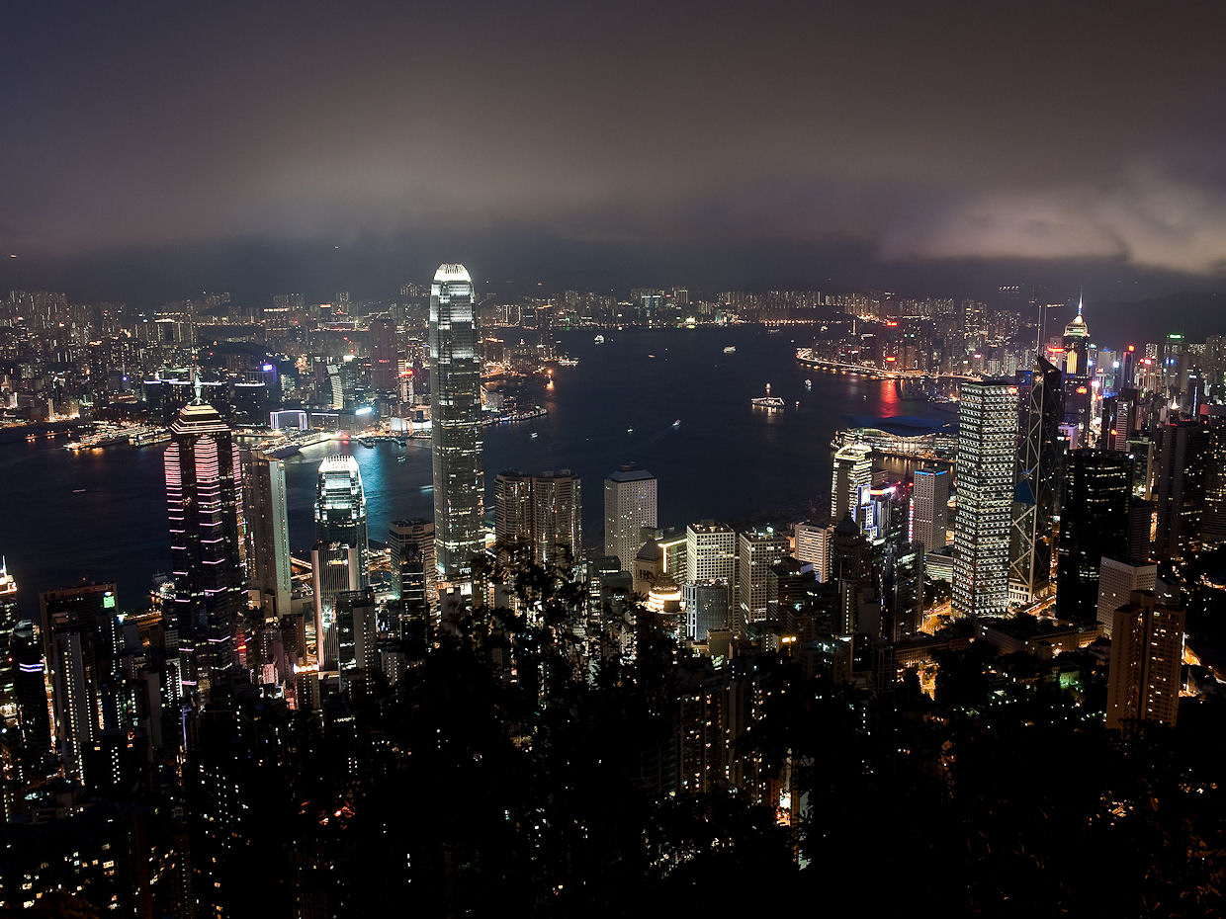
Jun 21, 2009 Before “Dim-it”
Credit: Sedonia Shu, Eimund Loo

Slide 16
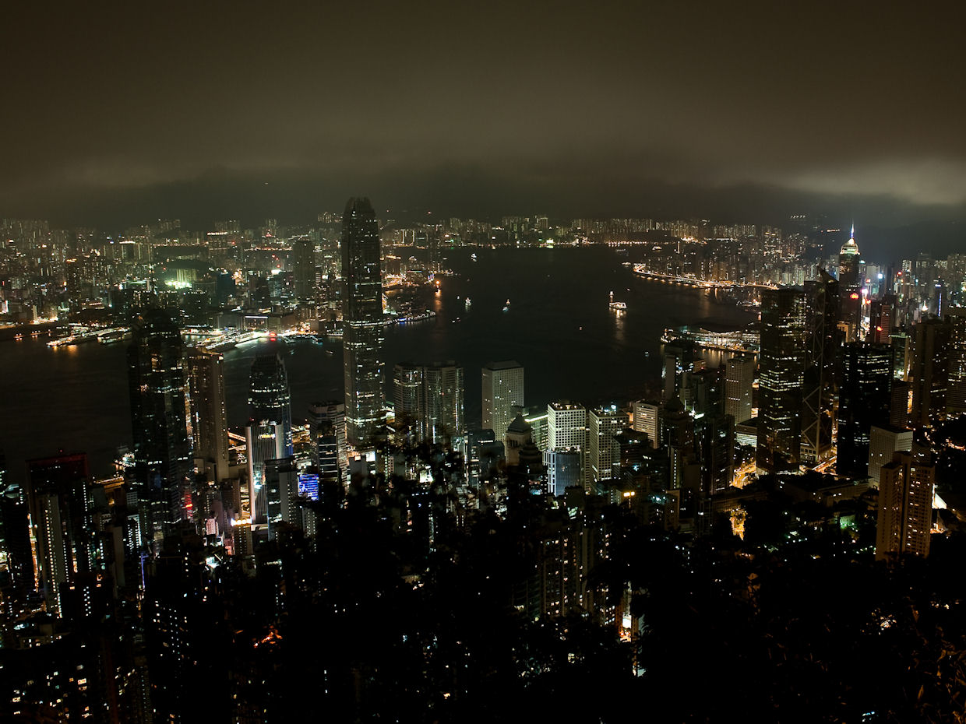
Jun 21, 2009 After “Dim-it”
Credit: Sedonia Shu, Eimund Loo

Slide 17
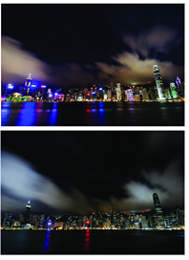
How to make this happen?
Good agenda (well planning)
Relate light pollution to daily life
Good partner (e.g. green group)
Media (good people)
Media (good timing, Mondays)
Media (good ideas or stories)
Media (concentrate – more frequent instead of more content)
Work hard
Before Dim It
After Dim It

Slide 18
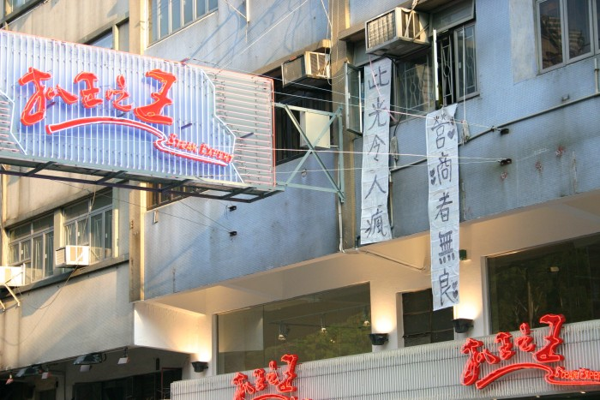

Slide 19


The Marriage
Environmental Party | Astronomical Party
Professional at media, networking | Professional at science
Focus on urban area lightings | Focus on rural area lightings
City Light Tour | Star Light Tour
Telephone Interview Poll | Light Pollution Survey
Dim-it Charter | Dark Sky Declaration
Light Pollution Exhibition | Astronomy Sidewalk
Photo Takings | SQM Measurements
Some budget | No budget

Slide 20
Date | Press Releases
22 Feb 2010 | Regulations of lighting hours are essential
6 July 2009 | Two ifc - Light Pollution Landmark
21 June 2009 | 6.21 Record-breaking Star-gazing: Lights Out Stars Twinkle
20 June 2009 | Dim It Forecast
18 June 2009 | Urge for setting up Star Gazing Conservation Zone
14 Jun 2009 | Dim It Brighten Up - A Starry Night on 6.21 Summer Solstice
11 June 2009 | No "Violent Urban Lighting"
31 May 2009 | 6.21 Dim It - Launch of Starry Night Low Carbon Dinner
25 May 2009 | "Violent Urban Lighting" widespread in Hong Kong - FoE calls for signing "Dim It Charter" and legislation of light pollution
11 May 2009 | Be A Good Earth Neighbour Hong Kong's First Dim It Charter In Force From June 21
11 May 2009 | First Stargaizng and light pollution tour start application tomorrow
28 Mar 2009 | FoE urges the government to regulate light pollution and set up conservation zone for star gazing
15 Feb 2009 | Saying Goodbye to a Starry Sky after the Farewell to a Blue One? Support 6.21 Dim-it - Stars Show

Slide 21
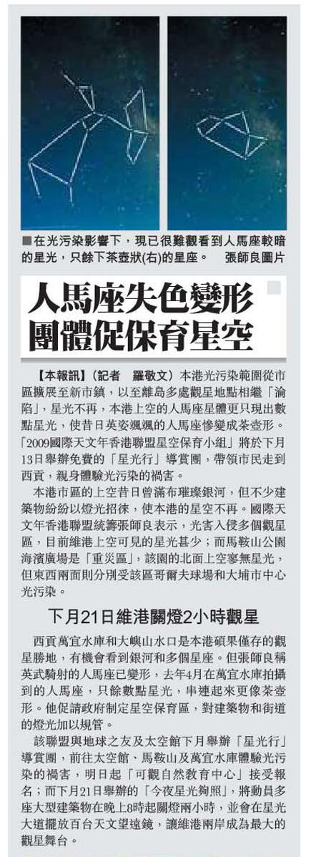
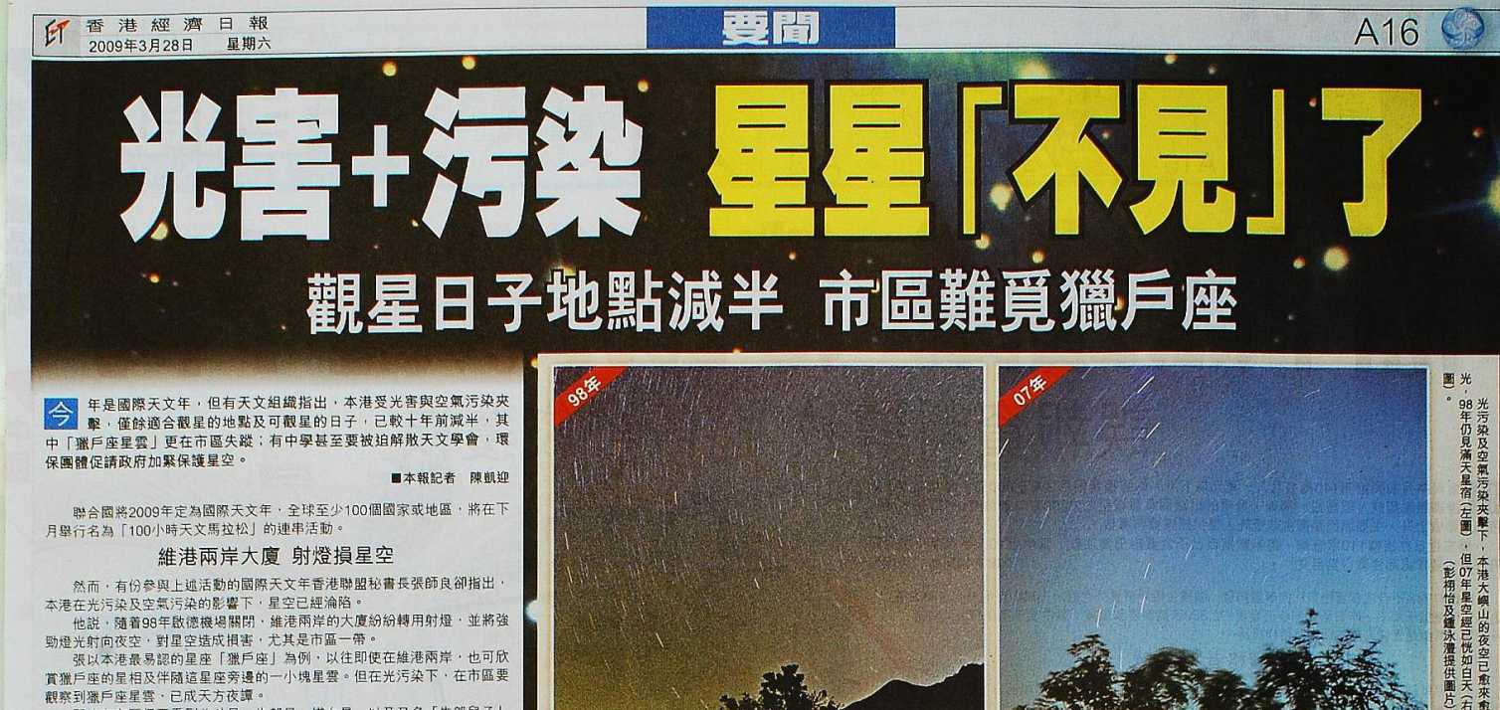
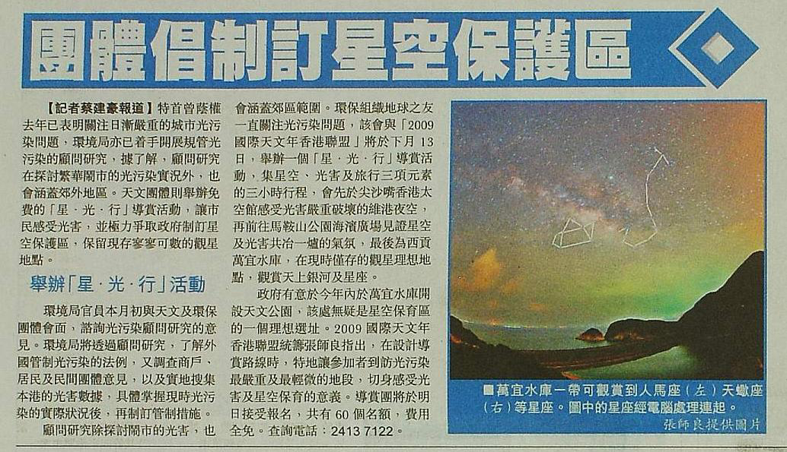
媒體報導
Notes:
21

Slide 22
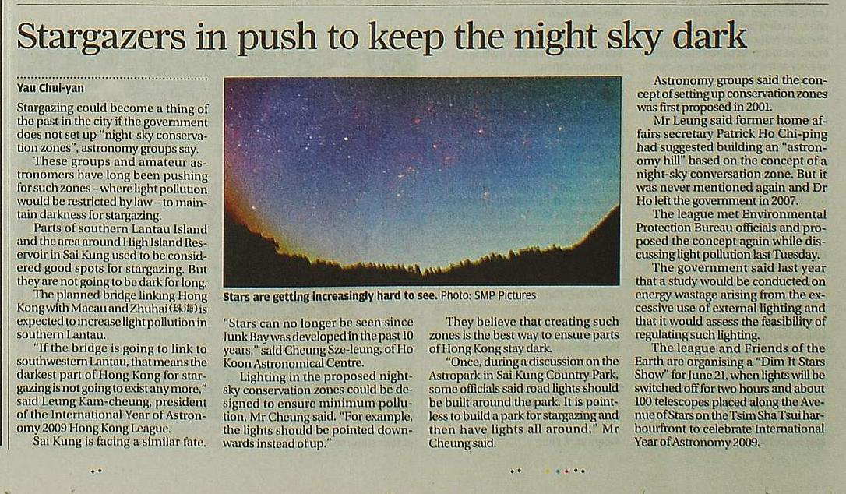
媒體報導
Notes:
22

Slide 23
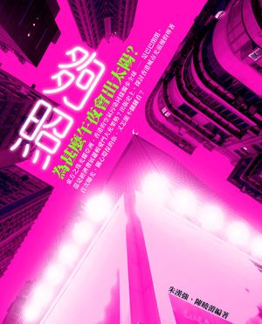
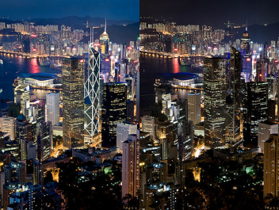
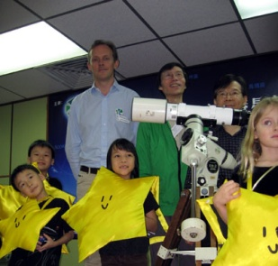
Timeline
 | Date | Event
 | Year 2003 | First Meeting with the government [The concept of Dark Sky Reserve was suggested, and in turn become the Astro Park now]
 | 2008-05-17 | Publication of the book "Dim-It“ [The first book solely for light pollution in Hong Kong, featured many stories]
 | 2008-06-21 | Dim It 2008 [142 buildings light off for 1 hour]
 | 2009-02-15 [one week after the local IYA Opening] | Kickoff press conference for Dim It 2009
 | 2009-03-28 [The day of Earth Hour, one week before 100HA] | Release the result of “Dim It Save Starry Night Survey” [In press conference, with very supportive results]
Notes:
Publication of the book "Dim-It“
[The first book solely for light pollution in Hong Kong, featured many stories]
Dim It 2008
[142 buildings light off for 1 hour]

Slide 24
Dim It Save Starry Night Survey Poll Result
Total Poll: 954
A global survey during IYL?

Slide 25
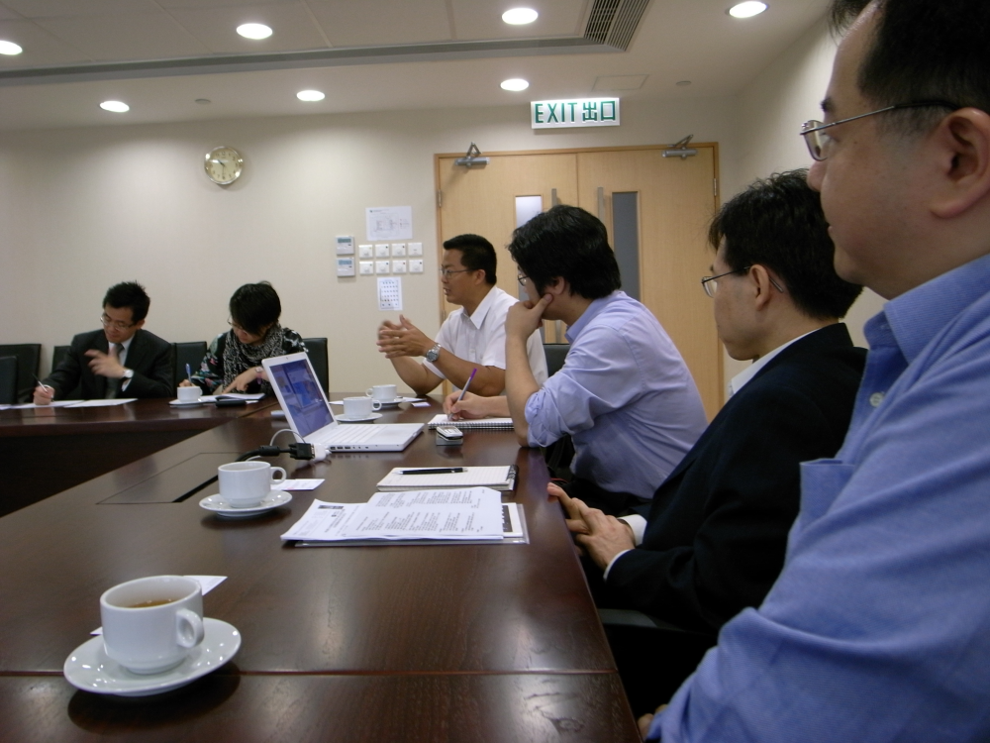
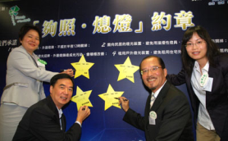
 | Date | Event
 | 2009-04-01 | Collections of “My Starry Memory” stories [Ask public, artist and politician to write]
 | 2009-05-05 | Meeting with government officials [1st time providing opinions on light pollution from the perspective of astronomy]
 | 2009-05-11 | Application of “Star Light Tour” [At last, 1200 applications out of 60 quota]
 | 2009-05-11 | Dim It Charter [Invite corporations to sign the charter, to switch off the light at 11pm. 575 buildings signed, and name those who don't sign.]
 | 2008-05-25 | Extreme Lighting Press Conference [Name the Violent Urban Lighting, 10000 lux lighting]
 | 2009-05-31 | Low Carbon Light Pollution Dinner
Notes:
Publication of the book "Dim-It“
[The first book solely for light pollution in Hong Kong, featured many stories]
Dim It 2008
[142 buildings light off for 1 hour]

Slide 26
 | Date | Event
 | 2009-06-11 [10 days before Dim It] | Release of the HKU Light Pollution Measurment Results [Another Press Release echo on the results]
 | 2009-06-11 [10 days before Dim It] | Press Release echo Survey Result
 | 2009-06-13 [2 days after the survey result released, 8 days before Dim It] | IYA Monthly Public Lecture – Light Pollution in Hong Kong
 | 2009-06-13 | Star Light Tour [However, cancel due to bad weather]
 | 2009-06-14 [7 days before Dim It] | Huge Press Conference on the Dim It event [Press Conf in a famous mall, with huge telescope set up]
 | 2009-06-18 [3 days before Dim It] | Publish of Dark Sky Declaration [10 short points to allow public easily read]
Notes:
Publication of the book "Dim-It“
[The first book solely for light pollution in Hong Kong, featured many stories]
Dim It 2008
[142 buildings light off for 1 hour]

Slide 27
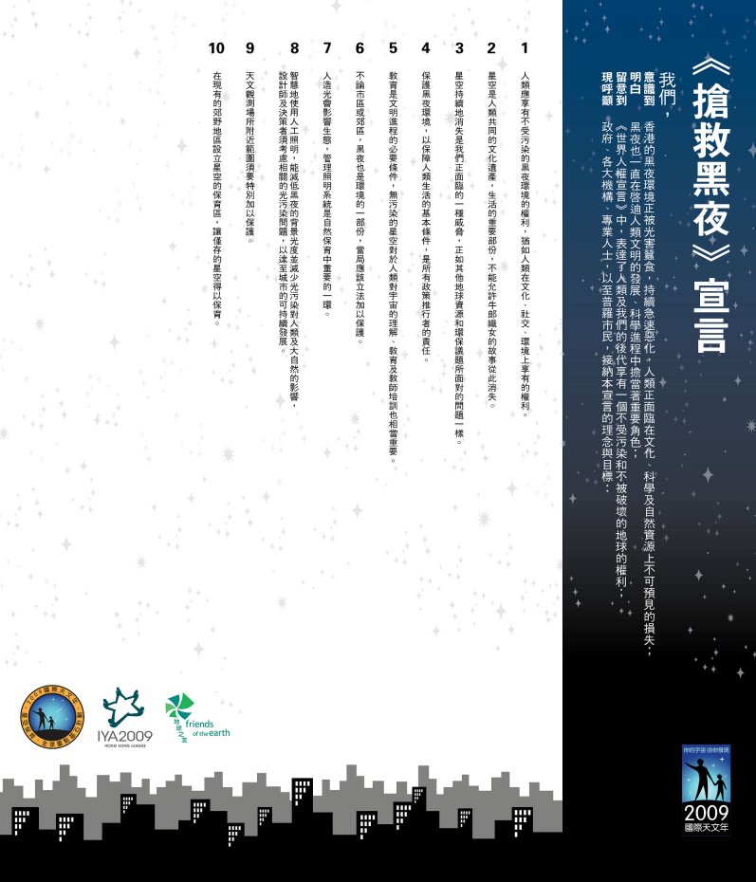
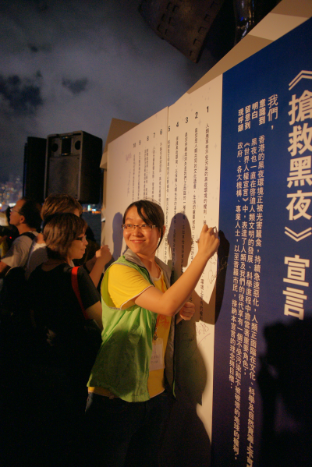

Slide 28
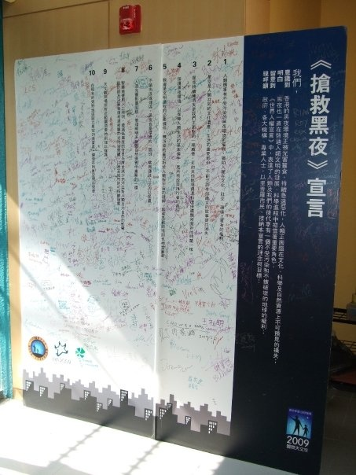
We can setup the signup interface online
Translate the file in different languages

Slide 29
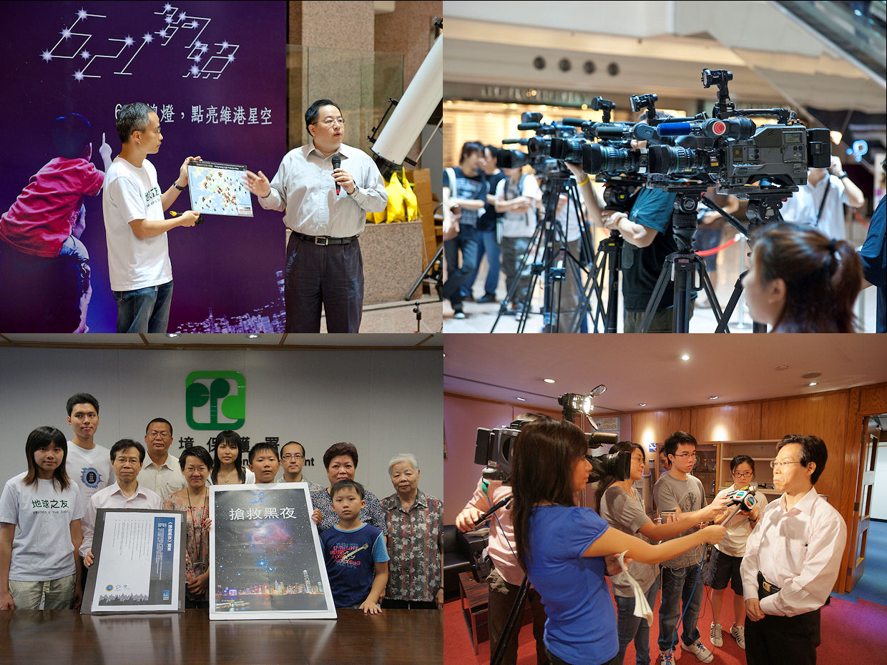

Slide 30
 | Date | Event
 | 2009-06-18 [3 days before Dim It] | “Save Dark Sky” Protest [Elderly and Kids as figures for news stories, press release]
 | 2009-06-20 [1 day before Dim It] | Star Light Tour
 | 2009-06-20 [1 day before Dim It] | Press Release - Breakthrough number 3468
 | 2009-06-21 | Dim It Light Pollution Exhibitions Astronomy Talks 50 Telescopes Count Down Event Low Carbon Dinner Galileoscope Workshop SQM Measurments [More than 50000 people, but it was cloudy]
 | 2009-07-06 | Central Light Pollution Study [As a followup]

Slide 31
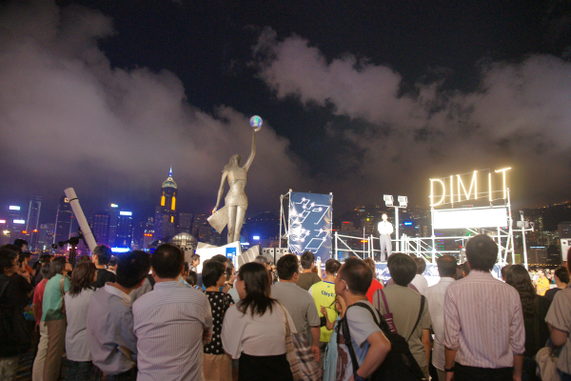
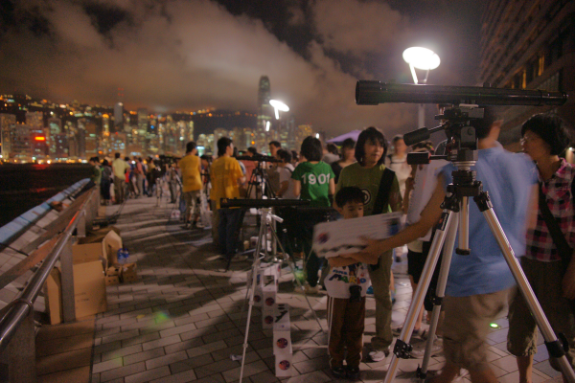
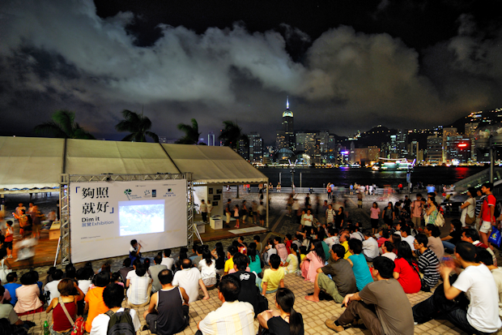
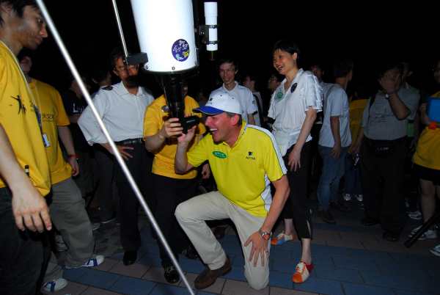
Notes:
31

Slide 32
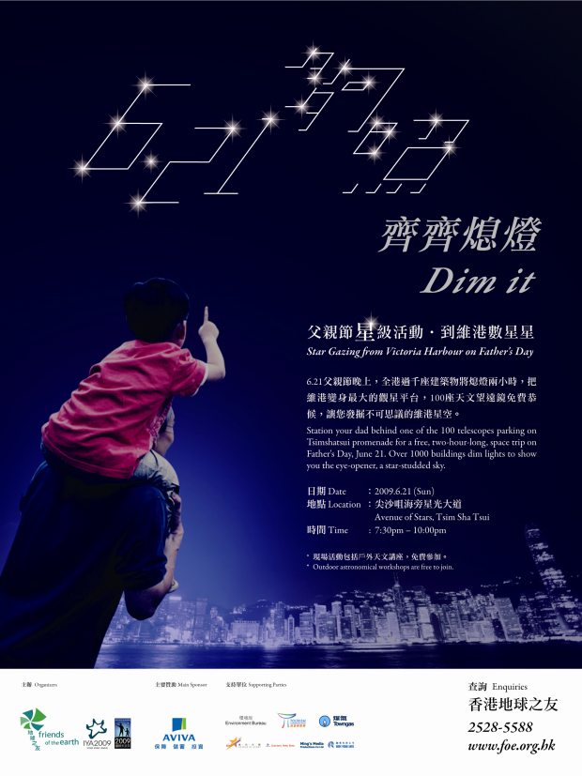
Lessons Learnt / Remark
* Media Play a VERY important role
* Ripples
* Father's Day
* Great cooperations among the environment group and astronomy group
Earth Hour
Important move towards set up the law

Slide 33
Light Off events in HK
Date | Organizer | Achievements
2008 June 21 | Friends of Earth | >142 buildings
2009 March 28 | WWF | >140 buildings
2009 June 21 | Friends of Earth, IYA HK League | >3500 buildings+organisations 50000 public for star party
2010 March 27 | WWF | >200 schools >2400 buildings+organisations
2011 March 26 | WWF | >300 schools >3000 buildings+organisations
2012 March 31 | WWF | >340 schools >3300 buildings+organisations
2013 March 23 | WWF | >370 schools >3800 buildings+organisations
becomes annual "common practice“, i.e. routine
mixed and defocused messages

Slide 34
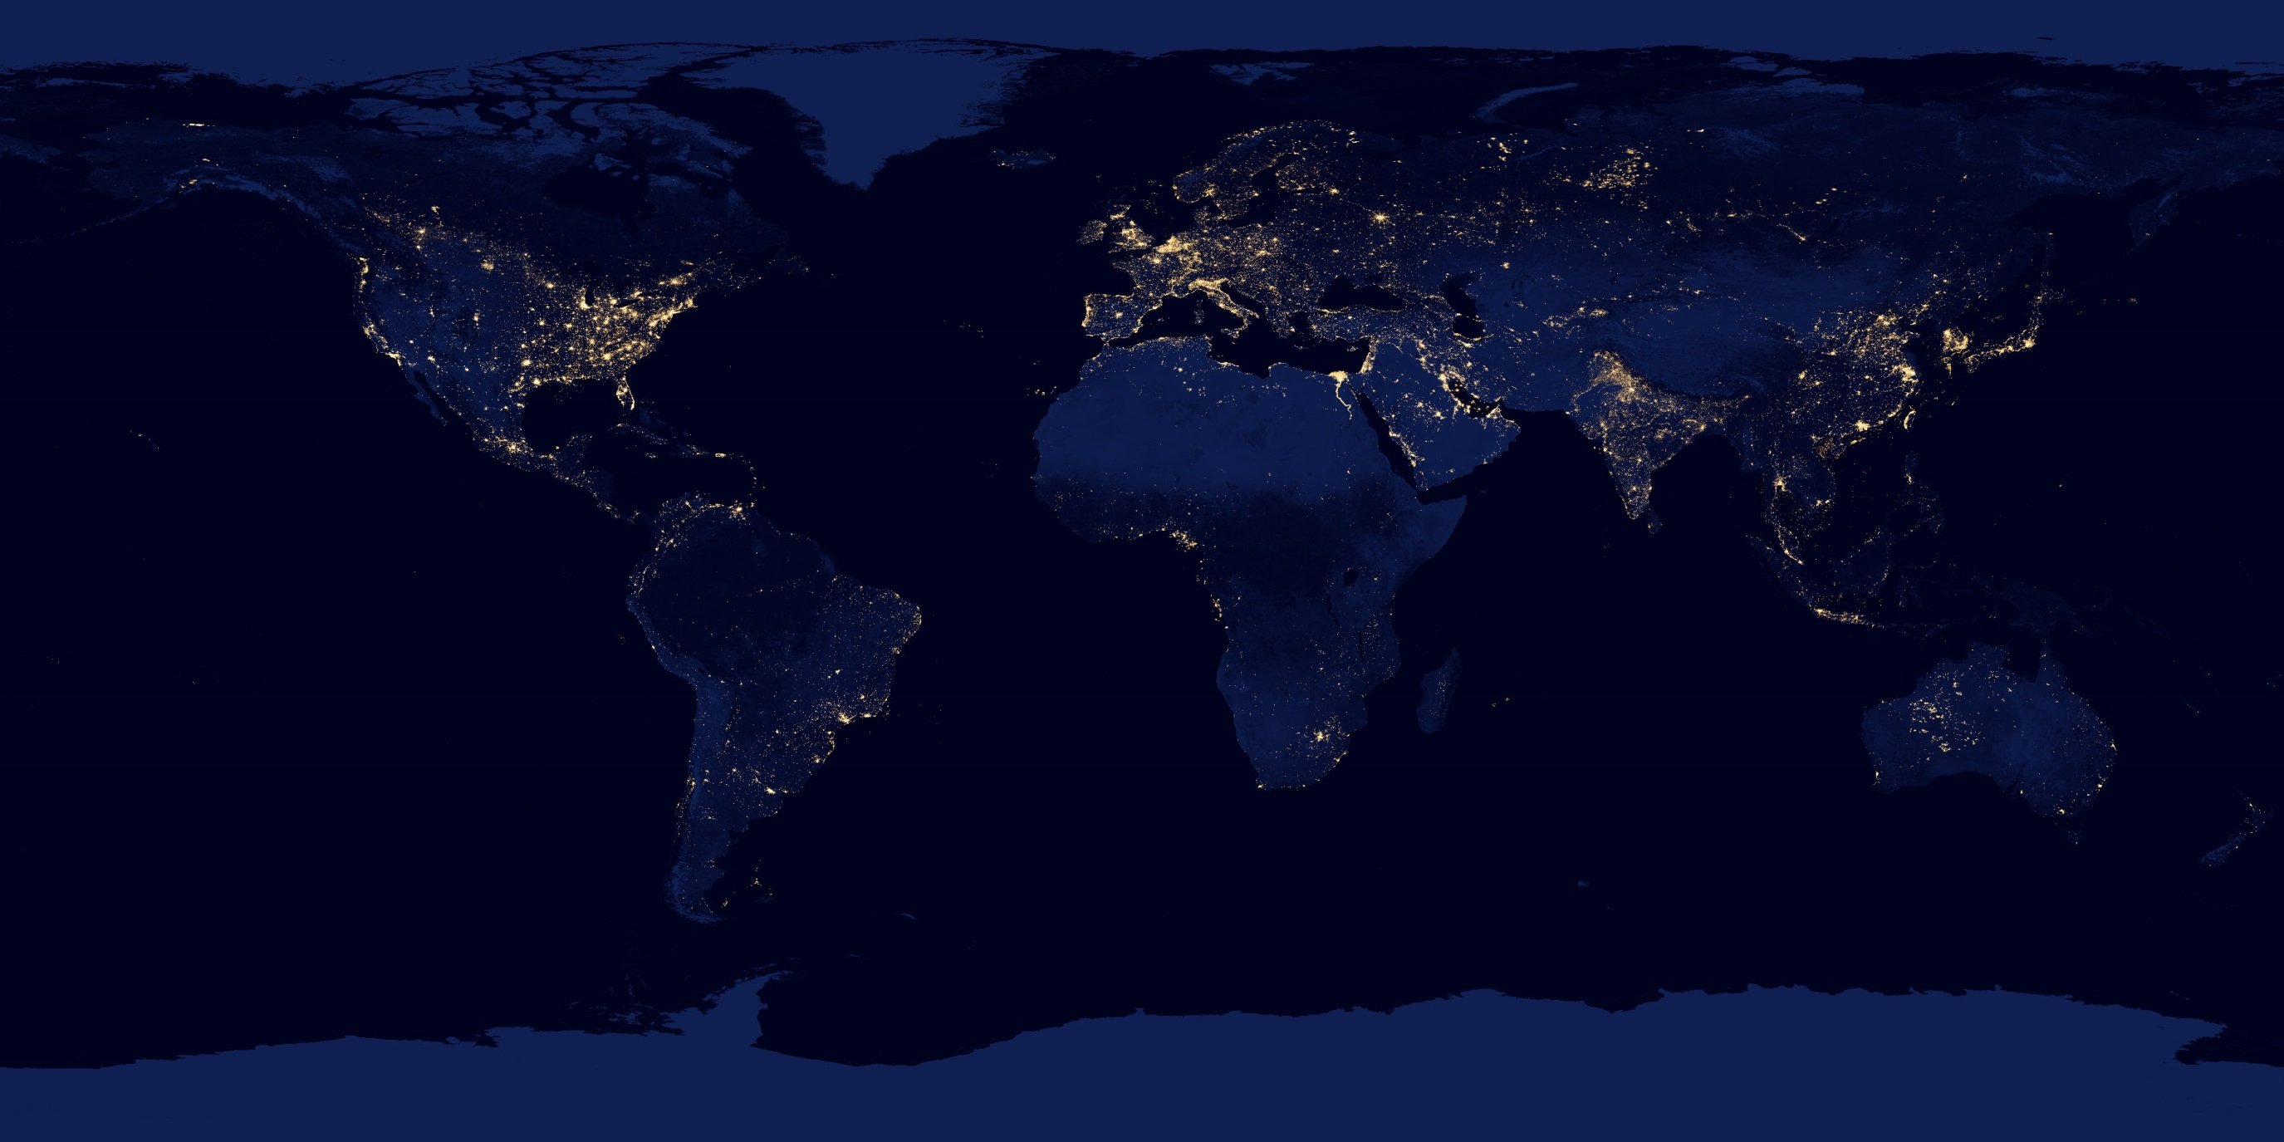
Dark Sky Measurement

Slide 35

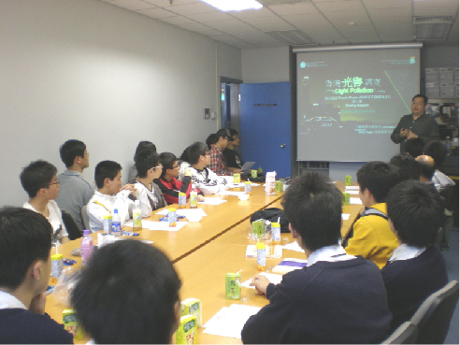
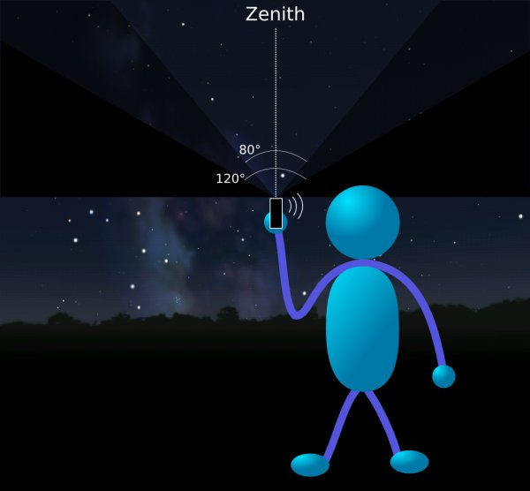
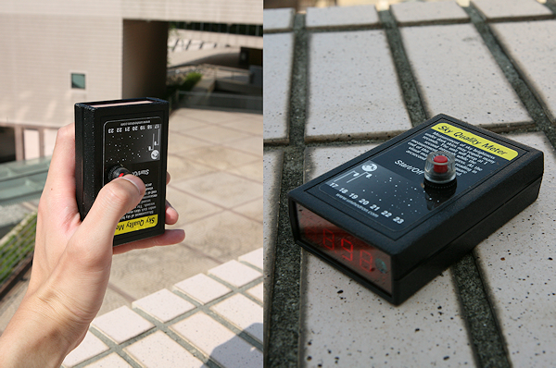
Strategy
Same time same date
Data Collection
From Mar 2008 - May 2009 (15 months)
171 volunteers, 1957 sets of data from 199 sites

Slide 36
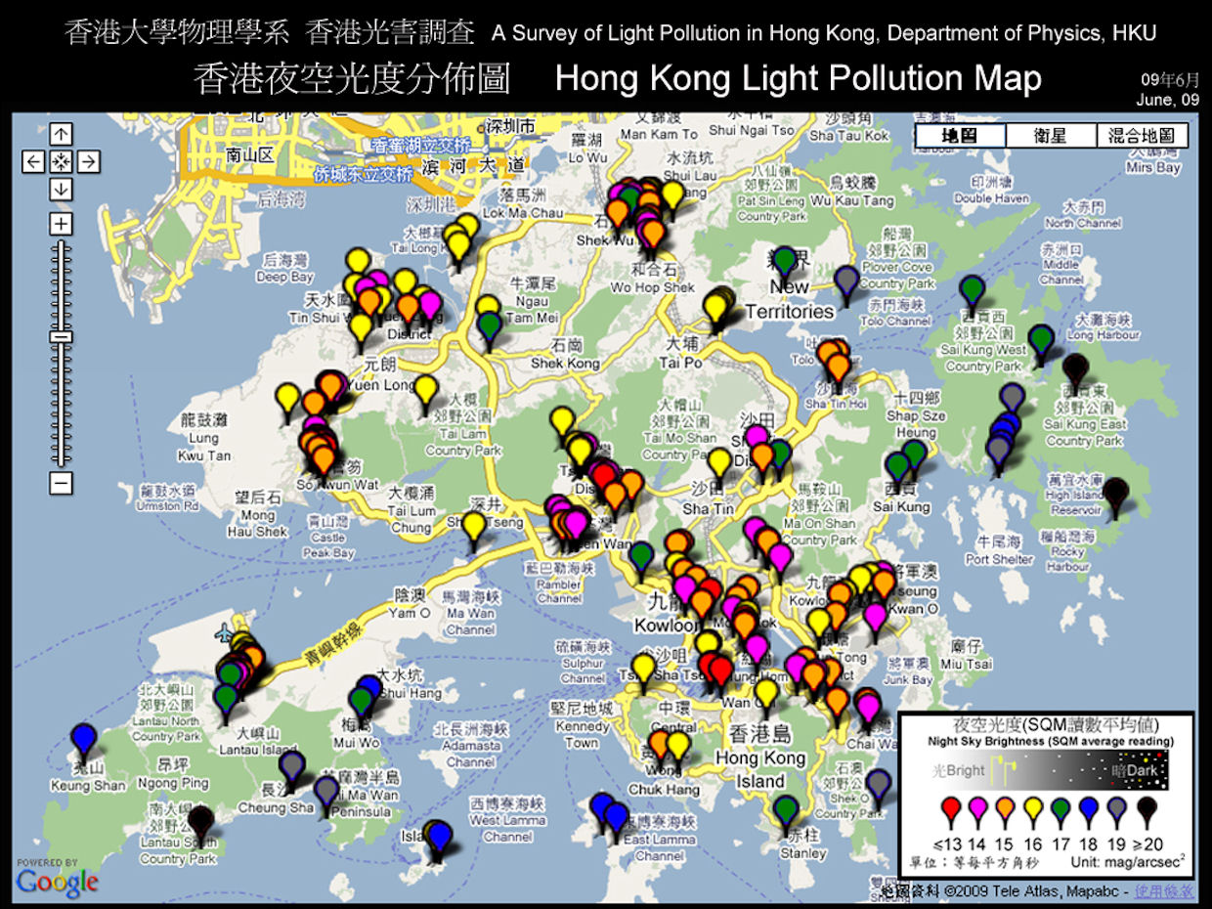
Result published during IYA2009
Urban skies 100 times brighter than rural sites
Brightest area is 500 times brighter than darkest location

Slide 37
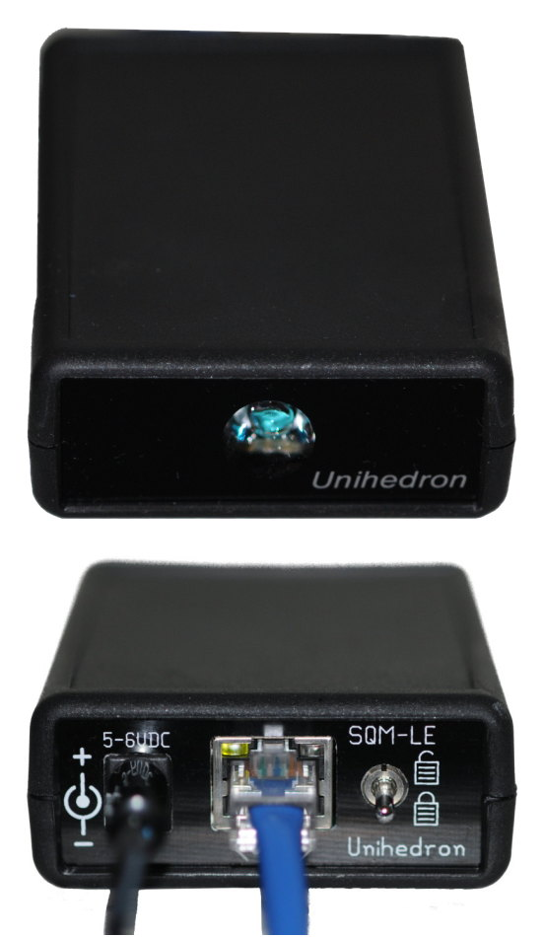
Sky Quality Meter - LE
Sky brightness reported in visual magnitudes per square arcsecond
Infrared blocking filter restricts measurement to visual bandpass
Ethernet connectivity
http://unihedron.com/projects/sqm-le/

Slide 38
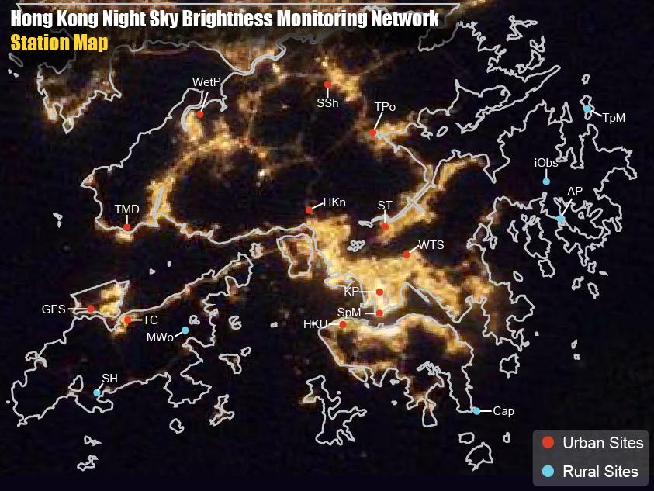
12 urban + 6 rural stations
~4.5 million individual NSB measurements collected between May 2010 and Feb 2013

Slide 39
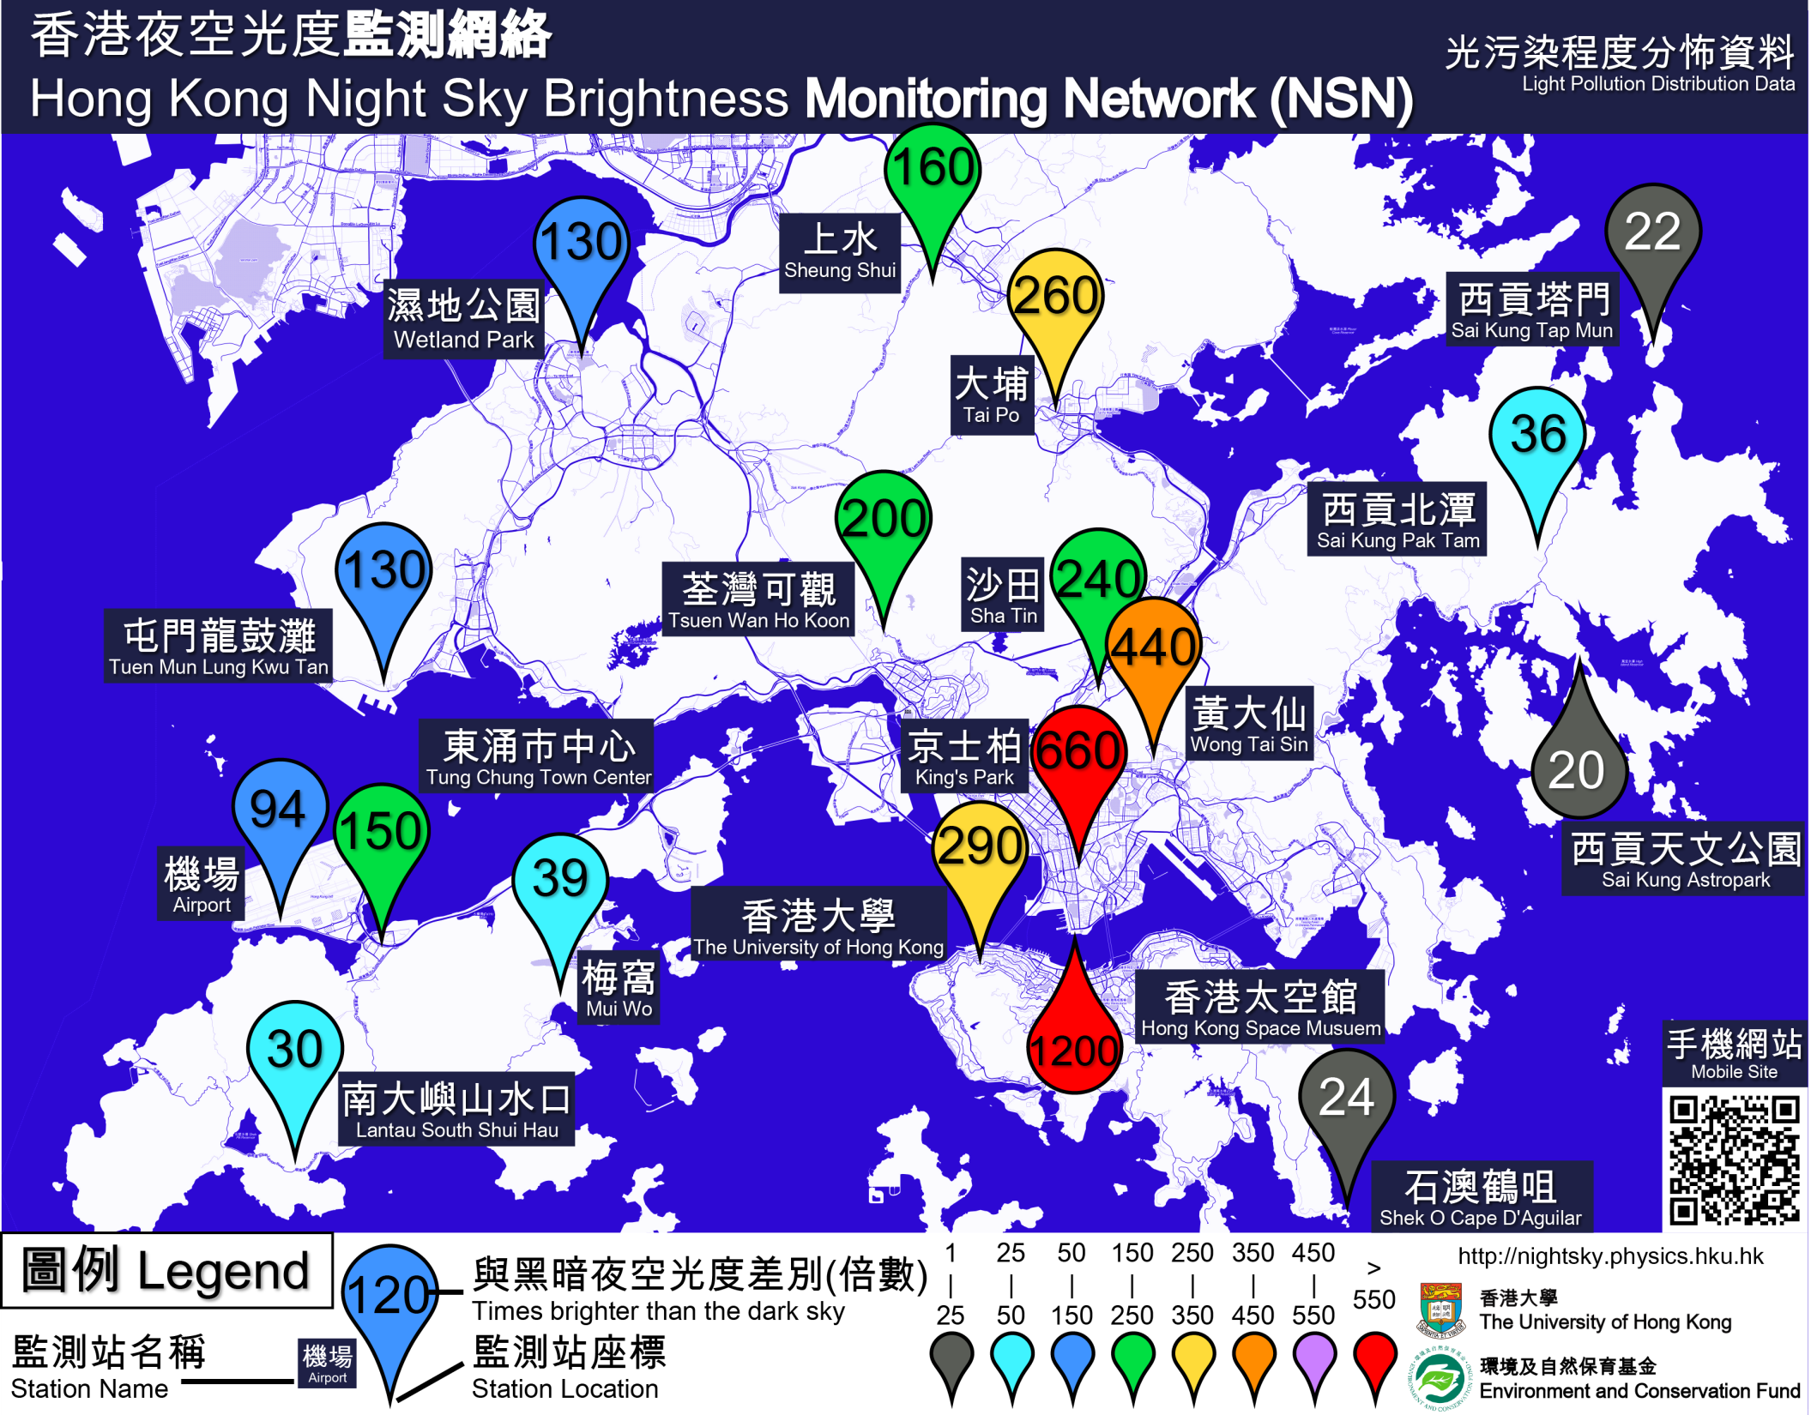
Result published 4 days before Earth Hour 2013
Brightest area is 1000 times brighter than natural dark sky

Slide 40
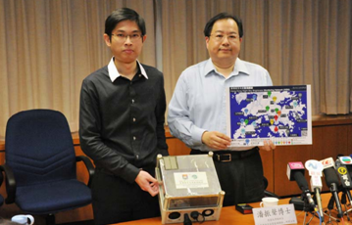
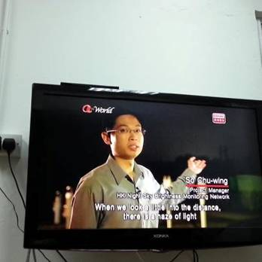
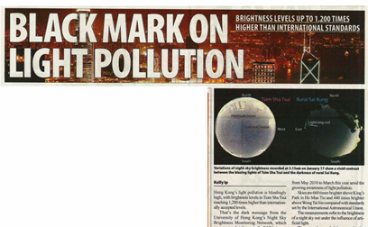
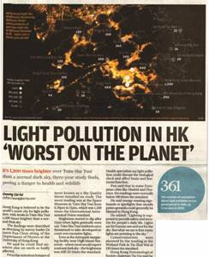
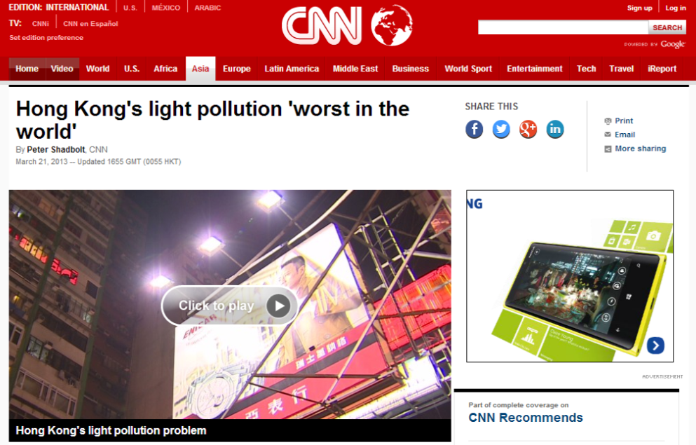
Media coverage
TV programs
Press
conference
Local
newspapers

Slide 41

Translation of the messages to the Media and Public
IAU definition: 21.6 arcsec mag^-2

Slide 42




Light Pollution Science Roadshow

Slide 43
Remarks
The art of (clever) working with media
A single, simple, direct message
Government need pressure
Less focus on astronomy (minority), but more on public concern (majority) – “Good lighting for health”
Identify government interest (e.g. astro-tourism)

